Slide 1

Introduction to Structured Query Language (SQL) For Business and Finance

Slide 2
Getting Started
Attendance: Please sign in using the Google Form emailed by Yu Chen
Open pgAdmin, and make sure you have all three databases loaded:

Slide 3
Your Instructor: Yu Chen

Slide 4



Cognitir
Cognitir was founded in August 2015 by David Haber and Neal Kumar. The company provides data science and web development courses designed for business and non-technical professionals. Given David’s technical expertise and Neal’s vast business & training experience both founders have combined their backgrounds to create world-class, practical training courses.
We always strive to create best-in-class products, so feel free to email us any comments on this course and/or new product ideas. Our email is feedback@cognitir.com.
We sincerely hope that you enjoy taking the course as much as we enjoyed creating it!
@cognitir
cognitir
cognitir

Slide 5
Terms and Conditions
The notes and relevant analyses are proprietary to Cognitir LLC. Distributing, copying, sharing, duplicating, and/or altering this file in any way is prohibited without the expressed written consent of Cognitir LLC.
The datasets used in the analyses are public information and can be found in public websites including:
Kaggle: Your Home for Data Science (Housing Database)
Sample Database: PostgreSQL (pagila_mod Database)
Northwind (Northwind Database)
Github Northwind PostgreSQL code (Northwind Database)
© Copyright 2015 Cognitir LLC. All Rights Reserved.
Authors: David Haber, Neal Kumar, David Wanner
Version: 1.1
www.cognitir.com

Slide 6
This Course
Designed for a range of business and nonbusiness professionals:
Cognitir provides a balanced framework of technical skills and business problem solving to enhance decision making.
Course Goals:
- Overview of different database technologies
- Experience working with relational databases
- Introduction to structured query language (SQL) and how to use it to access and utilize complex data to answer key business and strategic questions

Slide 7
Course Topics
Introduction
From Data To Tables
Most Important SQL Commands
Beyond the Building Blocks
In-Class Project
Final Exam
Summary & Q&A

Slide 8
INTRODUCTION

Slide 9
Section Overview
OVERVIEW
What is a Database?
Why are Databases important?
Relational vs. Non-Relational Databases
What Database technologies currently exist?
SQL & Databases
RDBMS vs. Excel
SQL vs. VBA
Notes:
Mention to class the this course does not go into database creation and adminstration. These are advanced concepts and unless you are working at a very small company or in a purely data analyst role, you will more than likely have a database administrator who does this for you.

Slide 10
What is a Database?
Information organized and stored in a certain way for effective retrieval.
The type of database used is a function of what the data is.
Data is stored in a database management system (DBMS).
Notes:
Data → stored in databases → managed by database management systems
DBMS → computer application system that interacts with the user, other applications, and the database itself to capture and analyze data.

Slide 11
Why are Databases important?
Organizes and stores information.
Allows easier retrieval of information.
Users can perform series of tasks with ease.
Improves operational efficiency and reduces business costs because information can be consolidated instead of fragmented.
Notes:
Operational efficiency → multiple people can work on data at same time, less redundancy of data given database structuring (unlike excel spreadsheets), accuracy, databases allow for more speed of pulling and reading data unlike excel,
Take it one step farther. Can you imagine not having data in electronic form? Think old school doctors and dentists office. This is an extreme case where data pulling is severely inefficient to operations.

Slide 12








Relational vs. Non-Relational
Information
Relational?
Non-Relational?
SQL DBMS
Non-SQL DBMS
Notes:
Relational means data is in table form (x by y). Think excel worksheet tables. They utilize something called Relational Algebra.
Non-relational means that data is not necessarily in table format. Technically you can use a non-SQL DBMS to pull table data but it’s not efficient. That’s why relational databases were created. But you can’t use SQL to pull non-relational data. Non-relational database just stores data without explicit and structured mechanisms to link data from different tables to one another.
This course focuses on relational databases given the popularity of such databases in the corporate world.
We chose PostgreSQL because of the community, easier install, power of advanced features, and integration with other tools such as Python/R, etc.. MySQL is another popular DBMS. Once you learn one, it’s quite easy to translate databases in one DBMS to another.
When would you choose a paid DBMS? You pay for one when you want somebody else to deal with all of your issues, you want certain storage, or you need technical support.

Slide 13
Relational Databases
Information is organized into tables of columns and rows.
Each row should have a primary key.
The primary key can be stored in other tables as a foreign key.
Tables should be related using logic.
RDBMS actions utilize ACID rules (outside of the scope of the course).
Uses SQL to retrieve, modify, and store information.
Notes:
Mention to students that this is a brief overview – more will be covered later.
For reference:
ACID = Atomicity, Consistency, Isolation, Durability → set of properties of database transactions.
https://en.wikipedia.org/wiki/ACID
Atomicity → all or nothing in terms of transactions. Prevents updates to databases occurring only partially
Consistency → any given database transaction must change affected data only in allowed ways. Any data written to the database must be valid
according to all defined rules, including constraints, cascades, triggers, etc..
Isolation → determines how transaction integrity is visible to other users and systems. Lower isolation increases ability of many users to access data at the same time.
Durability → transactions that are committed will survive permanently

Slide 14
SQL and Databases
SQL = Structured Query Language.
Designed by Donald Chamberlin and Raymond Boyce.
4th Generation Computer Language (4GL).
Used to work with data in a RDBMS such as PostgreSQL.
Different versions of SQL depending on the RDBMS but the “major commands” are supported by all RDBMS’.
Core 21st century business skill.
Notes:
4th Generation → higher level of abstraction from 3rd level. More programmer-friendly, powerful, and versatile. More closer to human language thus easier to use and work with.
“Major commands” → we will focus on these in the course. So, this course, while it will utilize PostgreSQL, it is actually RDBMS independent in terms of learning. So, if you find that you will use MySQL later – you will be fine. Some of these major commands include SELECT, WHERE, GROUP BY, JOIN, etc..

Slide 15
Relational Databases (RDMBS) vs. Excel
RDMBS Excel
Pros:
Information is stored logically
Can easily work with large datasets
Can run meaningful queries that can answer key strategic questions
Easy to collaborate on projects given DBMS setups
Cons:
SQL needs to be learned
Team might not be well-versed in RDMBS
Pros:
Good for smaller datasets
Easy to learn
Easy to manually enter and edit data
Widely used across the business and finance worlds
Cons:
Bad for larger datasets
Collaboration is hard
Not easy to “play” with data
No “formal” relationships among data in cells
“Buggy”
Bottom Line: Both are powerful tools that should be used in practice. The use of one tool over the other mainly depends on the underlying task, data, and collaboration needs!
Notes:
RDBMS:
A few more pros: avoid data duplication/data redundancy, greater data integrity, can control security – who has access to certain data and not others (data privacy), due to backup and recovery options – database can survive in crashes without corrupting the data.
Excel:
Not easy to play with data → there is VBA and pivot tables, but practitioners find that SQL is more powerful and easier
No formal relationships → any cell can be any data and there are no “rules” for the structuring of the data.
Buggy → Excel is notorious for crashing at the wrong time. One of Cognitir’s cofounders, Neal, used to be an investment banker. He would work on financial models that would crash at 2am often for a deck that was due at 8am. He almost threw his computer out the window a few times ☺

Slide 16
VBA vs. SQL
VBA:
Visual Basic for Applications.
Programming language that can be used with MS programs such as Excel to do powerful things.
For example, macros are written in VBA (or can be recorded in Excel).
SQL:
Used to manipulate data and structure of databases.
Can be written into VBA code
http://www.fontstuff.com/access/acctut15.htm
Bottom Line: Neither is “better” than the other. Both serve different purposes.
Notes:
VBA → Event Driven programming language: https://bytes.com/topic/access/insights/741543-vba-event-driven-programming
Macros written in VBA are much more powerful than the recorded ones because you can get really specific about what you want to do. There is only so much you can do when recording a macro. We are flirting with the idea of a course on VBA, so please let us know if you are interested in this topic!
Reiterate that we will be focusing on SQL in this course.

Slide 17

Section Recap: What Have We Learned?
SUMMARY
What is a Database?
Why are Databases important?
Relational vs. Non-Relational Databases
What Database technologies currently exist?
SQL & Databases
Databases vs. Excel
SQL vs. VBA

Slide 18
FROM DATA TO TABLES

Slide 19
Section Overview
OVERVIEW
Database Structure: A Network of Tables
Components of a Table
Connecting Tables Via Keys
Normalization High Level Overview
Viewing Network: ER Diagram
Views vs. Tables

Slide 20
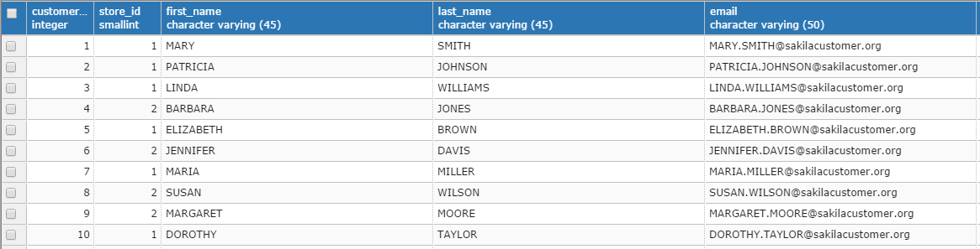
Database Structure: A Network of Tables
A database is a network of tables.
Each table can be thought of as a two-dimensional matrix or an excel spreadsheet:
Rows: The records, observations, individuals
Columns: The attributes, features, variables

Slide 21
Components of a Table
Each table stores unique data.
Components include:
Primary Key: Unique identifier for each row
Foreign Key: ID to connect to other tables
Notes:
Discuss how the PK is unique for this table, and the FK is going to link to the PK from another table that stores information about all stores.

Slide 22
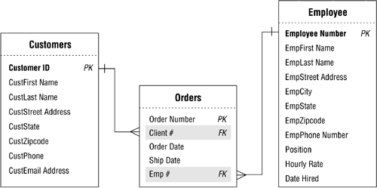
Connecting Tables Via Keys
Relating Tables: We reference another table by building a Foreign Key (FK) that can lookup values by referencing a table’s Primary key (PK)
Use the schematic to the right to:
Take an order and collect information about the customer.
Take a customer and view all of her orders.
View all of the orders an employee has been a part of.
Image Borrowed from: eTutorials.org
Notes:
Main point here is to establish how PK and FK work together; in this situation there is a table of just Customers, and a table of Just employees. We can use the orders table to pull information on orders customers purchased or orders employees were a part of.

Slide 23
Normalization High Level Overview
Relational Database means that data is stored in an efficient manner.
This process of storage is referred to as normalization and tends to fall on database administrator, database architects, software engineers, etc.
Notes:
Reminder: Most students will not need to build a database for their company, so having a high-level overview of normalization will be helpful.
TALKING POINTS:
Efficient means data must be stored in a unique way such that we:
Eliminate data redundancy
Easily update / delete / modify data

Slide 24
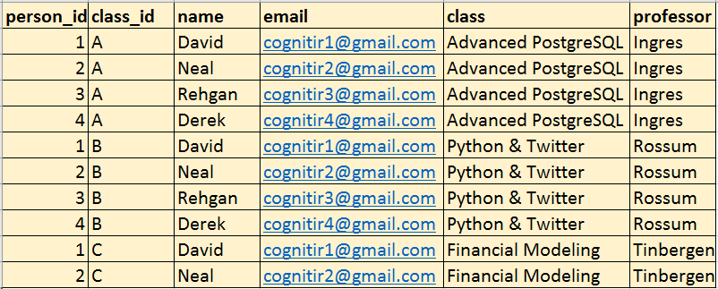
Normalization High Level Overview (cont’d)
Normalization allows us to organize tables into specific topics that make sense within our database.
Let’s look at a table that has not been normalized:
Issues we might have:
What if David drops out?
What is Rossum doesn’t teach this quarter?
What if Rehgan changes her email?
Advanced topics to study further: Third normal form, Boyce-Codd Normal Form
Notes:
These problems may seem trivial given the small number of rows, but imagine you are working with 500 million records; or with 1 billion transactions where customers have over 1000 purchases each….it starts to take up a lot of processing power.
TALKING POINTS:
Normalization provides more data integrity and control.

Slide 25
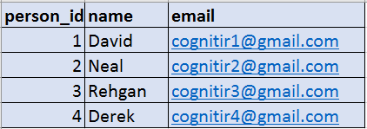
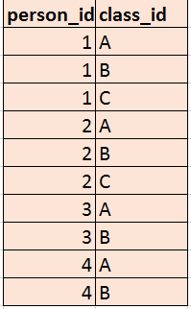
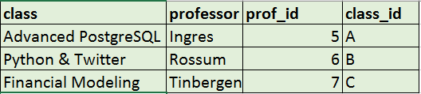
Normalization High Level Overview (cont’d)
Let’s compare to a normalized set of tables
Notes:
Main talking points:
Easier to understand what is happening to our data at a glance
We can modify a students email, without having to worry about updating all values
We could delete neal and David, but still keep our Financial Modeling class if other students wanted to take it

Slide 26
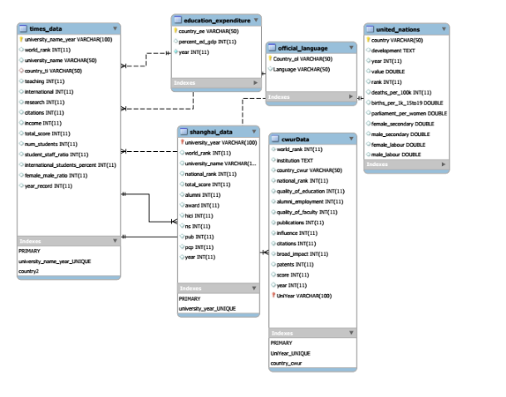
Viewing Network: ER Diagram
ER Diagram – Provides all connections within a database.
The following is an example of an ER Diagram created from a Kaggle dataset: World University Rankings.
Notes:
Main points: ER Diagram = Entity Relationship Diagram:
Allows us to see which tables connect to one another. Sometimes we get even better information, perhaps seeing FK and PK values.
TALKING POINTS:
Unfortunately, ER diagrams are not always provided at work.

Slide 27
Views vs. Tables
Oftentimes at a corporation with lots of analysts, consultants, data scientists, engineers, etc.. you work from a view rather than a table.
A table contains actual raw data.
A view is a “virtual table” built upon an actual table. A view references data from another location.
Advantages of Table: Ability to modify & update data, flexibility to view all components of database.
Advantages of View: Data security, simplified queries, ability to make “read-only”, memory “benefits”.
Notes:
Big takeaway: A lot of people will work with both types, and the querying is exactly the same.
Views - virtual tables essentially - company I was at provided analysts access to views only (no fear of underlying data changing since we had a team on the database side that took care of inserting/ modifying/ deleting data)
View Overview:
Data Security – You can limit the rows or columns that certain groups can see; limit data shared
Simplified Queries – If you need to combine a bunch of tables and do a bunch of SQL querying, you can just push out a view to a certain team to look at.
Read only: You might have a dedicated team of Database Architects or Software Engineers that clean your data. There is no need for analysts, consultants, data scientists, etc.. to be able to modify data.

Slide 28
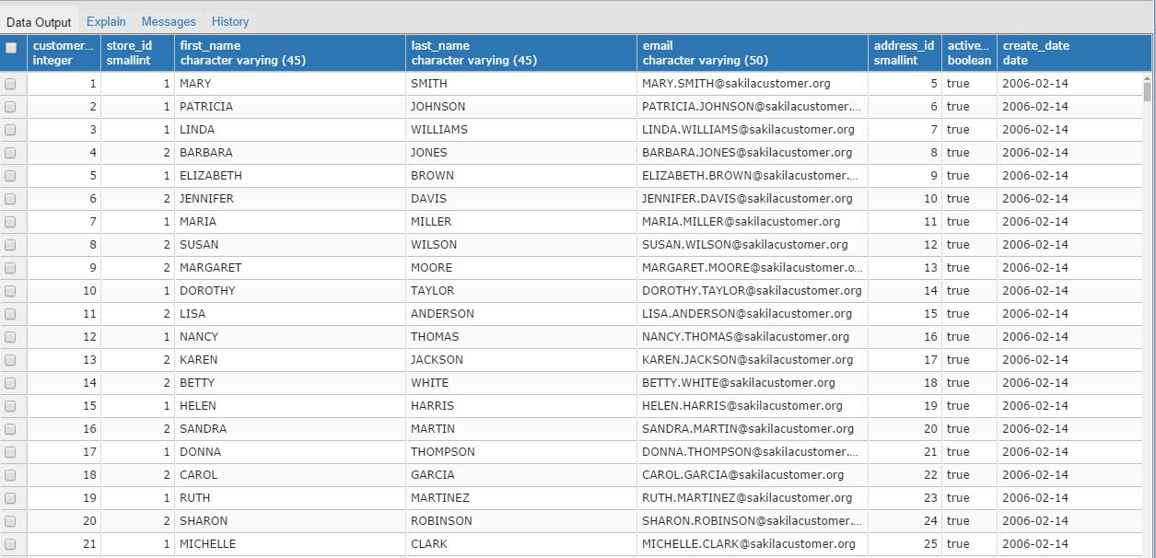
Views vs. Tables (cont’d)
No Difference! We can query the same way!
TABLE
VIEW
Notes:
Big takeaway: A lot of people will work with both types, and the querying is exactly the same. They look the same!
Also for your reference if you want to replicate in class:
CREATE VIEW sample_view AS
SELECT * FROM customers;
Then…..
SELECT * FROM sample_view

Slide 29
Section Recap: What Have We Learned?
SUMMARY
Database Structure: A Network of Tables
Components of a Table
Connecting Tables Via Keys
Normalization High Level Overview
Viewing Network: ER Diagram
Views vs. Tables

Slide 30
MOST IMPORTANT SQL COMMANDS

Slide 31
Section Overview
OVERVIEW
Loading Data / Databases
Cognitir’s Trifecta SQL Query-Building Method™
SQL Syntax
Debugging
Query Tips & How to Become a SQL Ninja
PostgreSQL Data Types
Comments
Most Important SQL Commands

Slide 32
Loading Data Into PostgreSQL
To learn how you would import/export data into pgAdmin – see the documentation below:
https://www.pgadmin.org/docs/1.22/using.html
Once the data is structured properly, the database is created, and the tables are set up – it is quite easy to load data into the database.
For Mac and Windows → pgAdmin 3 because 4 is buggy!
Notes:
@INSTRUCTORS: All dbs will be loaded before class starts.
Structuring databases, side note:
http://myweb.lmu.edu/dondi/share/db/relational1.pdf
https://www.ntu.edu.sg/home/ehchua/programming/sql/relational_database_design.html
TALKING POINTS:
This course is about being able to use SQL & NOT database design.
Multiple ways to import/export data – can use command line too (will be covered in an Advanced SQL Cognitir course).

Slide 33
Quick Note – pg Admin 3 and 4
Our screenshots are actually using the pg Admin 4 GUI.
This is on purpose! Because we are not using the latest pg Admin version in class, but you may be required to use version 4 on the job, so we wanted to expose you to both 3 and 4 in this workshop!
Your screenshots will use pg Admin 4 while the in-class instruction will use pg Admin 3. This instructional style is very well-received by attendees as they are exposed to both!
Please note: the differences between pg Admin 3 and pg Admin 4 are minor.
Notes:
@INSTRUCTORS: All dbs will be loaded before class starts.
Structuring databases, side note:
http://myweb.lmu.edu/dondi/share/db/relational1.pdf
https://www.ntu.edu.sg/home/ehchua/programming/sql/relational_database_design.html
TALKING POINTS:
This course is about being able to use SQL & NOT database design.
Multiple ways to import/export data – can use command line too (will be covered in an Advanced SQL Cognitir course).

Slide 34
Cognitir’s Trifecta SQL Query-Building Method™
Step 1: SELECT * from each table and see what all the tables have to offer.
Step 2: Plan in English first (SQL Pseudo-Code) – what business question are you trying to answer? Pen and paper exercise.
Step 3: Translate Pseudo-Code to SQL
COGNITIP: Multiple queries can answer your business questions. Pick the one that is simplest (KISS). Longer, more complex != better query!
Notes:
Walk through an example from housing DB. “I would like to know all the houses that have a living room square foot size larger than 1500 ft.” Looks like “size” table from housing DB can answer that. So we want to know which housing IDs have sqft_living > 1500.
SELECT house_id FROM size WHERE sqft_living > 1500;
This is the problem statement. Then you have to go through and think through what tables and columns can help you assess that.
STUDENT QUESTIONL
Why is a simply query better than a longer query?
ANSWERL
Takes less memory, less processing/execution time, easier to understand query logic, and makes it easier for your teammates to use the query if they need to.
KISS = keep it simple stupid. Simple is the best.
TALKING POINTS:
STEP 1 → May have to JOIN tables together, etc.. (covered later in the course).
STEP 2 → This is essentially the “algorithm design”.
STEP 3 → SQL = 4G language, so not hard to translate algorithm into SQL.

Slide 35
Cognitir’s Trifecta SQL Query-Building Method™ (cont’d)
Sample Problem Statement: “I want to know who the top customers are.”
Step 1: SELECT * from each table and see what all the tables have to offer.
Step 2: List out the potential SQL commands, tables, and columns that you will use.
SQL Pseudo Code: SELECT the customers and expenditure columns from the sales table but let’s ORDER the customers by expenditure in ASCENDING order and LIMIT to 20 results.
Step 3: Convert to SQL:
SELECT customers, expenditure
FROM sales
ORDER BY expenditure ASC
LIMIT 20;
Notes:
@Instructors: Step 2 – show on the board. Take a look at the slide called “Cognitir Trifecta SQL Query-Building Method”.
Step 3 – mention that this is only 1 solution.

Slide 36
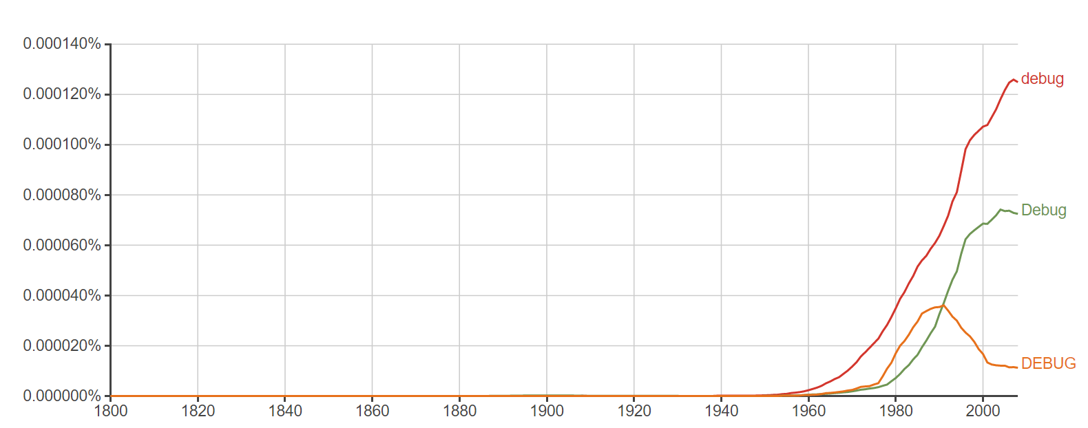
Debugging
Nobody can avoid running into errors when using SQL.
You can save yourself time and expand your skills by learning how to debug.
Debugging is the process of correcting errors, with process being key.
Plot taken from Google Ngram: “With computers came the need to debug”
Notes:
Just goes through and counts up the number of times “debug” is found across google books.
The Google Ngram Viewer or Google Books Ngram Viewer is an online search engine that charts frequencies of any set of comma-delimited search strings using a yearly count of n-grams found in sources printed between 1500 and 2008^{[1][2][3][4][5]} in Google's text corpora in English, Chinese (simplified), French, German, Hebrew, Italian, Russian, or Spanish;^{[2][6]} there are also some specialized English corpora, such as American English, British English, English Fiction, and English One Million; the 2009 version of most corpora is also available.^{[7]}

Slide 37
Debugging (cont’d)
First: Try to follow guidelines for syntax as best you can. This can make using PostgreSQL much more enjoyable.
The following are some reminders/ tips moving forward with SQL:
End statements with a semicolon (;)
a. Not necessary for all RDBMS but good practice.
Check that you are spelling column names correctly!
Try to capitalize statements (SELECT, ORDER BY, etc.) – it helps others help you!
Try to start a SQL statement on a new line.
Beware that certain functions do not transfer across RDBMS’ – some are DBMS specific!
If you cannot find your mistake, try reading your query backwards (back to front).
Notes:
This actually doesn’t matter in pgAdmin 4, but it does matter in other languages and can just be a pain at times
Good tips here too → https://mariadb.com/kb/en/mariadb/basic-sql-debugging/
For semicolon comment:
ASK STUDENTS: Why is it a good practice to end with a semicolon if it may not be necessary?
ANSWER: Because you may have to transfer your database to another RDBMS. If that new one requires a semicolon and you don’t have it – your query won’t work. This just saves times as all RDBMS will accept the ending semicolon therefore do it!
For backwards comment: This is a good programming tip. Reading backwards helps focus your attention on each single detail. Reading front to back often causes us to miss details. This is actually a good tip when creating PowerPoint presentations and word documents – read back to front.

Slide 38
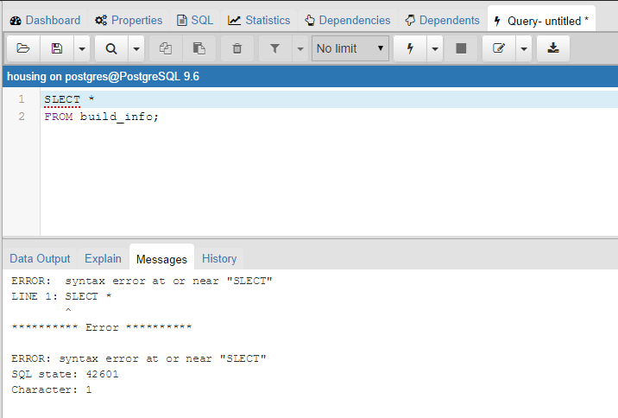
Debugging (cont’d)
But, errors will still arise – this is okay!
pgAdmin 3 is great at catching errors & provides a lot of helpful information:
Notes:
Obviously, we can see we need to spell SELECT correctly. Luckily pgadmin 4 points us in the correct direction

Slide 39
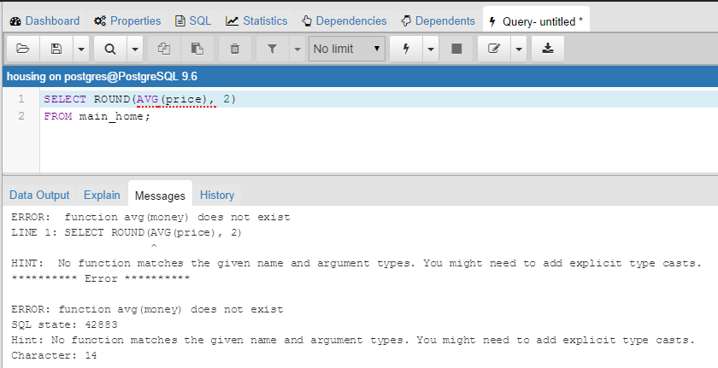
Debugging (cont’d)
Other errors will be less clear: Enter PostgreSQL Documentation
https://www.postgresql.org/docs/9.1/static/datatype-money.html
Notes:
Show students documentation so they have an idea of how to find it and how to look through it.
Mention that both the pgAdmin 4 and PostgreSQL documentation is in the appendix.

Slide 40
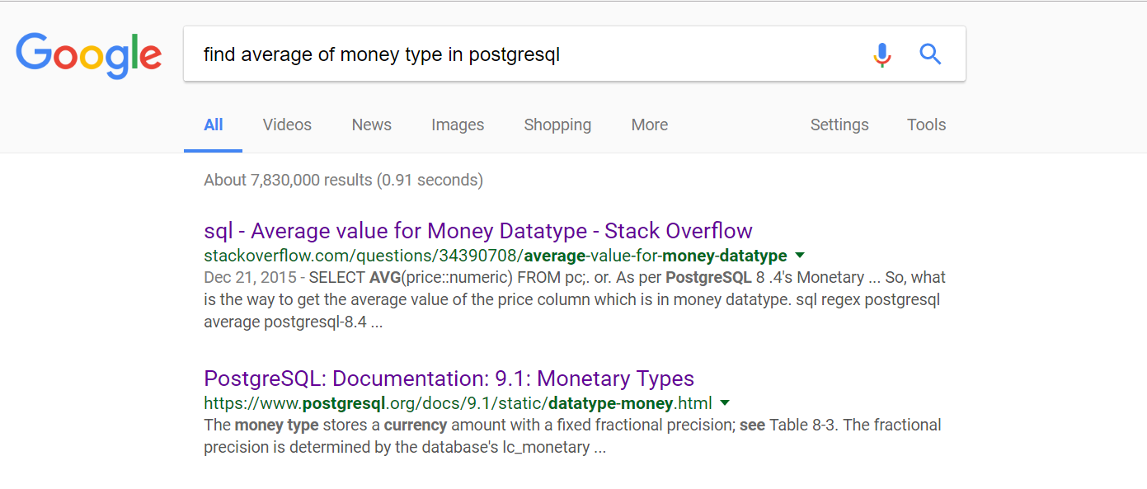
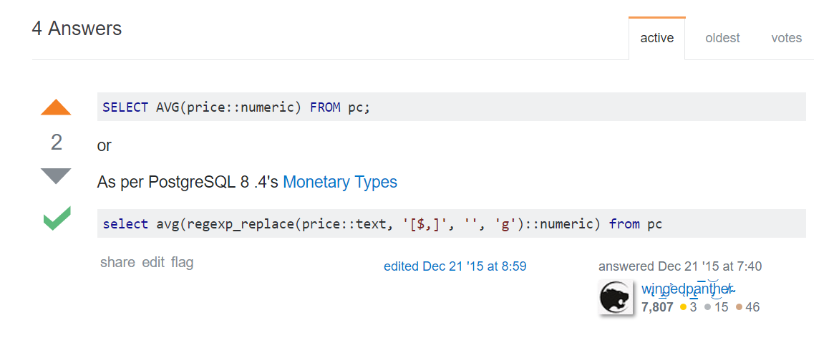
Debugging (cont’d)
That wasn’t the most helpful this time, what about stackoverflow.com?
Notes:
This time we found the help we needed! Go through this live with students – it is extremely important that they feel confident enough to do this on their own.

Slide 41
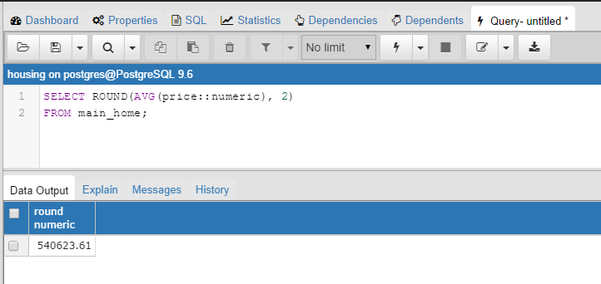
Debugging (cont’d)
Documentation showed that “money” and “numeric” type could be converted.
Stack showed us a similar error and a solution.
Notes:
Main point: When debugging you should utilize all of these resources.

Slide 42
Debugging (cont’d)
Cognitir Debugging Steps:
Is your syntax an issue?
Can pgAdmin 3 provide helpful error messages?
Does the documentation online help?
Has somebody had a similar error at stackoverflow?
Notes:
We of course want to weigh how much time we are spending.
Mention that the PostgreSQL and pdAdmin documentation links have been provided at the very end of this course deck.
Quickly show stackoverflow.com → “stackoverflow and postgresql and how to delete a database if there are active connections to it”

Slide 43
Query Tips
Include the full names of databases and tables as opposed to shortened versions.
E.g., schema_name.table_name.column
Look for simpler solutions
Keep a running journal of errors that you encounter
Make sure your query tool is for the right database!
Sometimes pgAdmin does not work and/or querying freezes. If this happens, just restart pgAdmin.
Notes:
ASK STUDENTS: Why is long name preferred to shortened versions?
ANSWER: Because it can help you find and fix your errors, especially when creating JOIN statements. It’s also crystal clear to the query recipient exactly where information is coming from.
EXAMPLE re point 1: Assume we have a database called cognitir and a table called customers with columns customerid, firstname, lastname, address, and another table called sales with customerid, seminarlocation, seminardates, repeatcustomer). It’s best to specify specific columns by using notation cognitir.customers.customerid and cognitir.sales.seminarlocation, etc.. This way, it is super clear what you are referring to as opposed to short form notation (if column is unique PostgreSQL does not require you to specify database and table precursor).
Simpler solutions → Many OR statements or IN statement?
Running Journal of Errors → the original query, the error message, and the correct query. Personal “Knowledge Management System”
Right Query Tool → Often times, practitioners run a syntactically correct query but it does not work because it is querying the wrong DB!

Slide 44
How to Become a SQL Ninja
Take your time! Think through each problem first and plan!
Practice makes perfect.
The more you do, the better you’ll get.
This is why our course is so practical and hands-on – you learn by doing!
Find a friend in here and every month one creates a database and business Qs and the other answers them – alternate.
Do all these exercises over and over again!
Get an internship during the year! SQL is a highly sought after skill.
Find a professor or a PhD student who needs help with research – chances are they work with some relational databases.
Notes:
Mention that this course is not supposed to expose every single aspect of SQL – this is not practical. This section is about covering what we and many practitioners deem to be the most important SQL commands. There are obviously more. Always check the documentation for the version you are working with to learn about additional functionality.

Slide 45
PostgreSQL Data Types
There will be some variation in data types across different RDBMS’.
Can create new datatypes in PostgreSQL using CREATE TYPE SQL command (outside of the scope of course).
Below are some of the most common data types in PostgreSQL:
Boolean (0 = false; 1 = true)
Character
Character (n)
Character Varying (n)
Integer
Integer
Serial
Auto_increment in other RDBMS’
Floating Point
Double precision
Time
Timestamp [p] / Timestamp [p] with time zone
For other data types and additional information, see the documentation:
https://www.postgresql.org/docs/9.6/static/datatype.html
Notes:
There are definitely other data types – these are just the most important ones.
Boolean → if value is unknown, NULL is used. Space = null
Character(n) → n is the number of characters. Fixed length character string. If string is less than character(n) then postgre will pad with spaces. If more, postgre will return an error. All strings are the same length. This is to ensure that users doesn’t enter in string that does not belong in that column
Character varying (n) → Variable-length character string. if string is less – no space padding. Often used with a customer or employee name.
Integer → signed 4 byte integer
Serial → autoincrementing 4-byte integer. Numbers are unique to each row. Main use could be for a PRIMARY KEY (discussed later)
Double Precision → double precision floating-point number (8 bytes)
Timestamp [p] → date and time (no time zone). P is related to precision (number of total digits)

Slide 46
Comments
Used to explain parts of SQL queries – not part of query execution.
Can also be used to prevent execution of certain SQL query sections with the aim of testing/debugging a specific SQL query section.
Single-line comments → --
Make sure to include a space after the double dash.
Multi-line comments → /* at beginning and */ at the end
Notes:
TALKING POINTS:
Explain parts of SQL queries → helpful when handing off a project or collaborating with others – so they have an idea of what you are doing.
You know you are commenting if you see the font of comment area change to a consistent color.

Slide 47
SELECT
Used to select data from a database.
The most important SQL function.
The results are stored in a result set.
When trying to understand table relationships, should always be the first query you run
Notes:
Do a quick overview of pgadmin 4 – show how to use query tool, execute a simple query, where tables/servers/ properties
Result set → This is really just a fancy way of saying “results table”.
A SELECT will return relevant rows based on the query specifications and columns.
Automatically closed when query is rerun or another query is run.
Need to save as a view or a new table if you want those results again.
Why first query you should run? So you can visually see what columns exist, types of data you are dealing with, and relationships among columns across tables in your database.

Slide 48
SELECT (cont’d)
In housing database, right click the database, and select “Query Tool”, we will build our first query together:
We will now select all rows and columns from the “build_info” table in housing database.
SELECT *
FROM build_info;
Notes:
Asterisk = everything.
Otherwise, replace asterisk with specific columns that you want separated by comma.

Slide 49
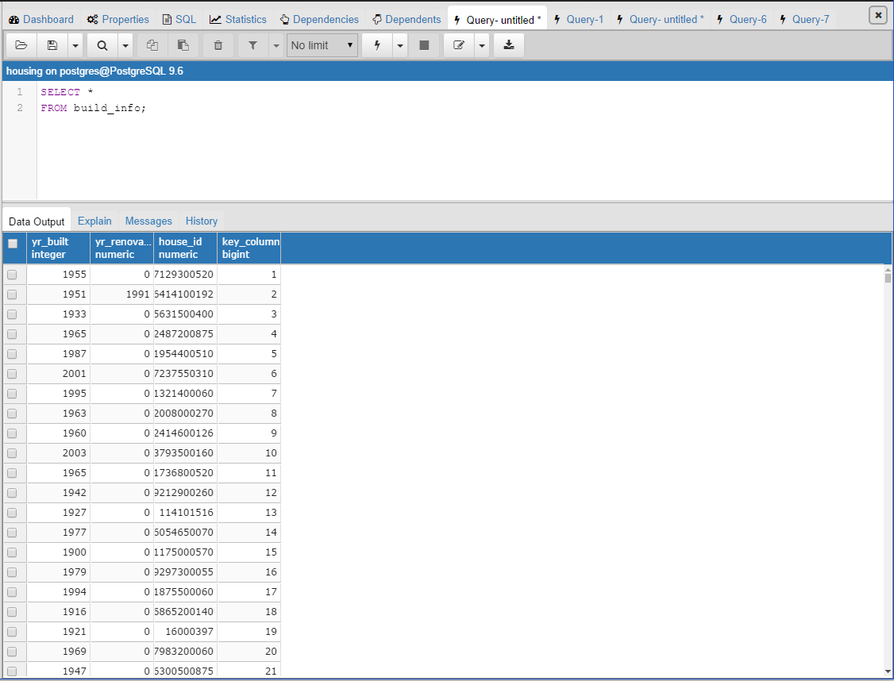
SELECT (cont’d)
This is what the result set looks like:
Result Set

Slide 50
SQL Exercises I
Exercises:
Open up the Query Tool in pagila_mod database and create the following:
SELECT statement that selects everything from the category table.
Create a SELECT statement that returns the phone and postal code from the address table.
Create a single SELECT statement that returns everything from the city and country tables together.

Slide 51
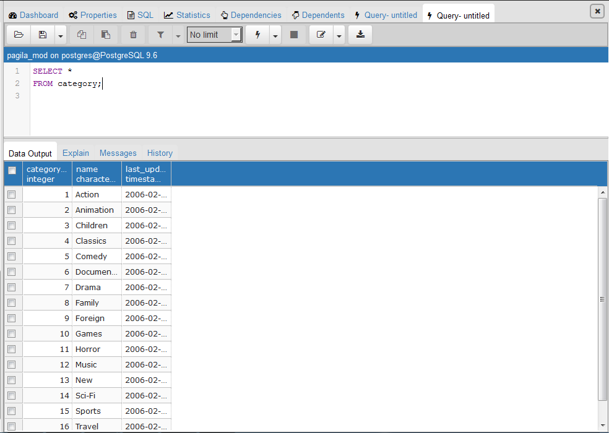
Solutions
1.
COGNITIP: You do not have to click “green arrow” to execute. F5 is the execute shortcut on PCs and Macs!
*This screenshot (and all the others) use pg Admin 4, so green arrow = lighting bolt in this image.*

Slide 52
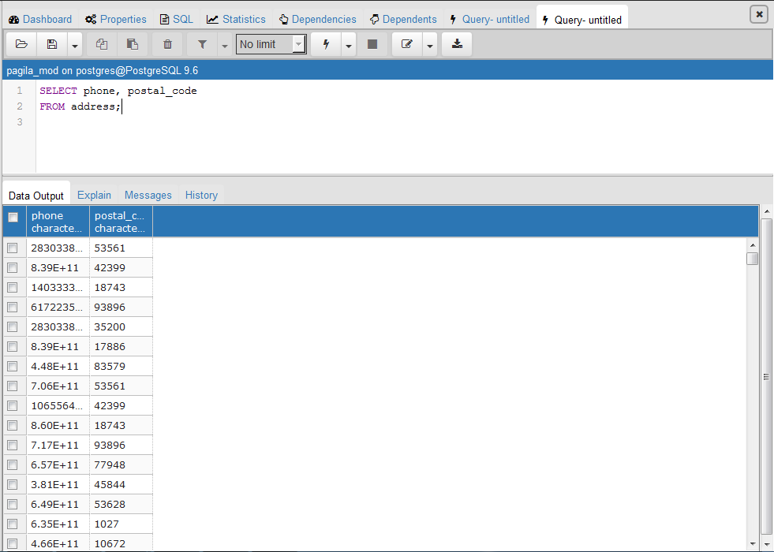
Solutions (cont’d)
2.

Slide 53
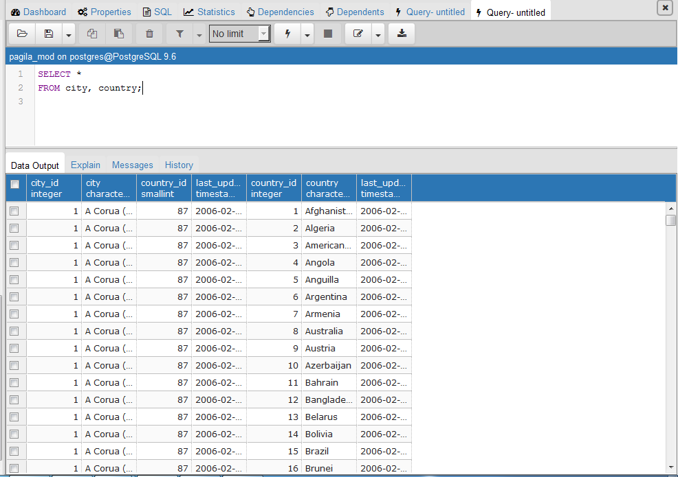
Solutions (cont’d)
3.
Notes:
Tell students this might take a few more minutes as we are pulling a great deal of information – be patient!

Slide 54
SELECT (cont’d)
Some more basic SELECT functions:
Check out the PostgreSQL documentation to learn more about additional SELECT functionality:
https://www.postgresql.org/docs/9.6/static/sql-select.html
SELECT price AS house_cost
FROM main_home;
SELECT size.house_id, size.sqft_lot + size.sqft_above AS value
FROM size;
Notes:
SKIP THESE QUERIES – tell students they can run this later. Just additional functionality. AS will be introduced later.
Do these queries in class so they can see it – “I do.”
This renames the price column to house_cost. This comes in handy when the column names are not very intuitive or if they are very long and you want to shorten them in a rather long and complex query.
This returns the house_id column and adds together sqft_lot and sqft_above to create a new column called value. You can also add columns across tables, but you have to make sure to specify the table: table_name.column_name and in the FROM you have to include all tables that you are using. Why is the a helpful tool? Perhaps you need to create a unique identifier. So adding together a day, month, and year could return a unique ID number that could be used for some business purpose. Or, in this real estate example, may the size of the lot and above part of the house are key value drivers for price, so we want to see the houses that have the largest lot and above part of house values as one summation.

Slide 55
LIMIT
Returns only a specific number of rows from a query.
SELECT location_table.latitude, location_table.longitude
FROM location_table
LIMIT 10;
Notes:
If no ORDER BY is used then it returns the first x amount based on whatever was inputted into the database (based on the entry/input of the data). That’s what happened in our example. In this example, we selected the first 10 latitude and longitudes – no order specified.
Limit → Very helpful if your table has an extremely large amount of rows.
Limit → Often used with SELECT * to understand “column contents”.
Limit → Often used with ORDER BY (covered shortly) to get “top x number” or “worst x number” of a column.
Limit → can be used with another SQL function called OFFSET to skip a certain number of rows first.

Slide 56
COUNT
Returns the number of rows from a query.
NULL values are not counted in COUNT.
NULL means info is missing or blank
Not the same thing as empty string or zero!
SELECT COUNT(zipcode)
FROM location_table;
Notes:
This query returns 21,436. This means that there are 21,436 zipcodes entered in (not including NULL).
ASK STUDENTS: What about if I want distinct zip codes?
ANSWER: Stay tuned! We are about to talk about this!

Slide 57
DISTINCT
Returns only the unique values in a column.
Counts NULL.
SELECT COUNT(DISTINCT(zipcode))
FROM location_table;
Notes:
Can be used with GROUP BY (covered later) to assess how many groups do you have and how many are in each group (COUNT).
This query returns 70. This means that there are 70 distinct zipcodes (not including NULL values) in our table. Imagine how powerful the combo of COUNT and DISTINCT can be in answering certain business questions. Notice the difference between this query and the one before – subtle but important.

Slide 58
ORDER BY
Returns output in a specific order (ascending or descending).
Can have multiple orders of ordering (e.g., first ascending order by column x then descending order by column y).
ASC for ascending and DESC for descending.
SELECT DISTINCT(zipcode)
FROM location_table
ORDER BY zipcode;
Notes:
Can be used with LIMIT to find out “largest” and “smallest” values in a column.
If you do not specify ASC or DESC, ASC is default choice.
This query returns all the unique zipcodes in ascending order (default). If I want descending order, I would specify DESC.

Slide 59
OPERATORS
Used often with WHERE (discussed next)
Allows you to create “tests” where if met you pull some information from the database.
= Equal
> Greater than
< Less than
>= Greater than or Equal
<= Less than or Equal
<> or != Not Equal
AND Logical AND operator
OR Logical OR operator
If you are using this for a test with text, you must use single quotations (not double)
Notes:
Mention this will make more sense in just a bit when we discuss WHERE
Show example of single vs double quote on board

Slide 60
WHERE
One of the most important and versatile SQL commands that returns particular rows based on certain conditions.
Conditions could utilize operators (previous slide), BETWEEN, IN, LIKE, etc..
SELECT house_id, yr_renovated
FROM build_info
WHERE yr_renovated <> 0;
Notes:
ASK STUDENTS: What’s another way you could have structured this query using operators?
ANSWER:
SELECT house_id,yr_renovated
FROM build_info
WHERE yr_renovated > 0;
Why? Because non-renovated homes are given a value of 0. I noticed this when I “studied” the table in the SELECT * step.

Slide 61
BETWEEN
Used often with WHERE
Equivalent to using greater than or equal to and less than or equal to in a conditional
NOT BETWEEN
SELECT house_id, yr_renovated
FROM build_info
WHERE yr_renovated NOT BETWEEN 2008 AND 2010
AND yr_renovated != 0;
Notes:
ASK STUDENTS: What do you think this query will do?
ANSWER: Return all the house IDS and yrs renovated for those houses that are not between 2008 and 2010 but are renovated (!= 0 part).
Remember, 0 = not renovated given how our database administrator set up this database.

Slide 62
IN
Used often with WHERE and subqueries (discussed later)
Equivalent to a bunch of OR statements
NOT IN
SELECT house_id,yr_renovated
FROM build_info
WHERE yr_renovated IN (1991, 2002, 2008, 2010);
Notes:
Often used with subqueries too. So, subquery would replace the value in IN statement. (covered later).
ASK STUDENTS: Why use IN instead of a bunch of OR statements?
ANSWER: Readability and speed of execution. IN is much easier to read than a series of OR statements. And, an IN statement is executed much more quickly than a series of OR statements.
This query returns house IDs and yr_renovated for houses that were renovated in 1991, 2002, 2008, and 2010. As we said, a bunch of OR statements.

Slide 63
LIKE / ILIKE
Basic “pattern matching” tool
Often used with WHERE
Basic format: SELECT column_1, column_2, column_3…FROM table_name WHERE column_x LIKE ‘A%’;
Returns all values that start with A
% = wildcard → any sequence of characters
_ = wildcard → any SINGLE character
ILIKE = case insensitive
Other ways to “pattern match” – see documentation:
https://www.postgresql.org/docs/9.6/static/functions-matching.html
Notes:
Both wildcards can be used in beginning, middle, or end of a string test.
Maybe show a quick LIKE/ILIKE example via Pagila.

Slide 64
Bringing These SQL Commands Together
SELECT yr_built, house_id
FROM build_info
WHERE yr_built >= 1940
ORDER BY yr_built ASC;
SELECT house_ids
FROM house_details
WHERE bedrooms BETWEEN 2 AND 4
AND bathrooms > 1.5
AND condition IN (3,4);
SELECT latitude, longitude
FROM location_table
WHERE house_id LIKE '9%';
Notes:
Instructors will copy and paste this into pgadmin
ASK STUDENTS: What do you think the first query will do?
ANSWER: Query 1 → returns the house_ids for the houses built on and after 1940 and sorts it in ascending order. Run it in class
ASK STUDENTS: What do you think the second query will do?
ANSWER: Query 2 → returns the house_ids for houses that have between 2 and 4 bedrooms, have more than 1.5 bathrooms, and are in a condition of 3 and 4. Run it in class.
ASK STUDENTS: What do you think the third query will do?
ANSWER: Query 3 → returns an error! Why? Because house_id is a numeric data type. Wildcards work on strings! Run this in class.
ASK STUDENTS: So, what’s alternate way to achieve the intended outcome for Query 3?
ANSWER:
SELECT *
FROM location_table
WHERE house_id BETWEEN 8999999999 and 10999999999;
Or could use greater than or less than. Again, this works because house_id is a numeric data type.

Slide 65
SQL Exercises II
Exercises:
Open up the Query Tool in pagila_mod database and create the following:
SELECT statement that selects everything from the rental table.
Using inventory table, create a statement that employs SELECT and WHERE to select the store IDs that are not equal to 2. Return the timestamp for rows that meet these requirements.

Slide 66
SQL Exercises II (cont’d)
3. Using film table, return the DISTINCT movie ratings.
4. Using film_actor table, COUNT the
DISTINCT actor IDs.
5. Using film_category table, return film IDs and category IDs WHERE category IDs are BETWEEN 3 and 10 (including 3 and 10).
6. Using address table, return the district names that have city IDs greater than 300 OR less than 250

Slide 67
SQL Exercises II (cont’d)
7. Using film table, create a SQL statement that uses the LIMIT, WHERE, ILIKE, and % wildcard to LIMIT the output to first 20 movies where “Awe-Inspiring” is in the description. ORDER BY movie name, alphabetically. Return the movie name, description, and rental rate.
8. ADVANCED: Using country table, return the country IDs and names WHERE the country name starts with ‘A’, ‘B’, OR ends in ‘esh’. Hint: You may have to explore stackoverflow.com and/or PostgreSQL documentation for the answer.

Slide 68
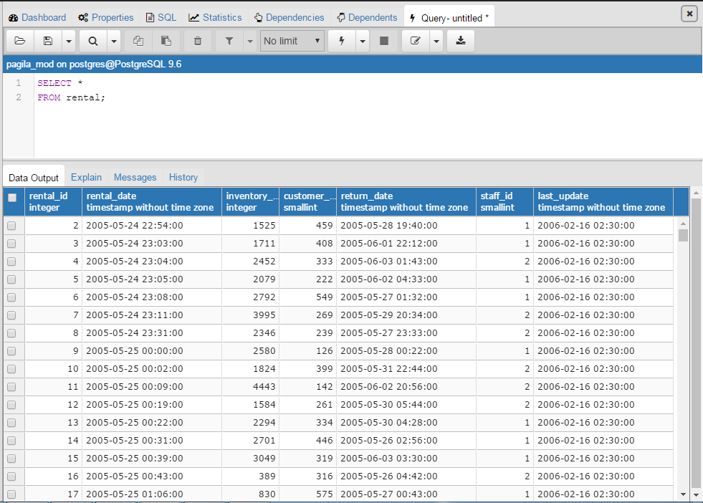
Solutions
1.

Slide 69
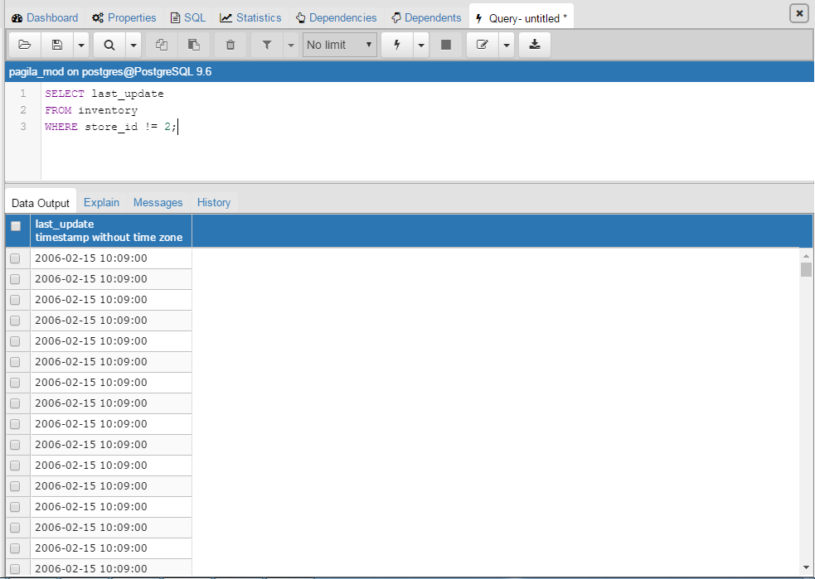
Solutions (cont’d)
2.

Slide 70
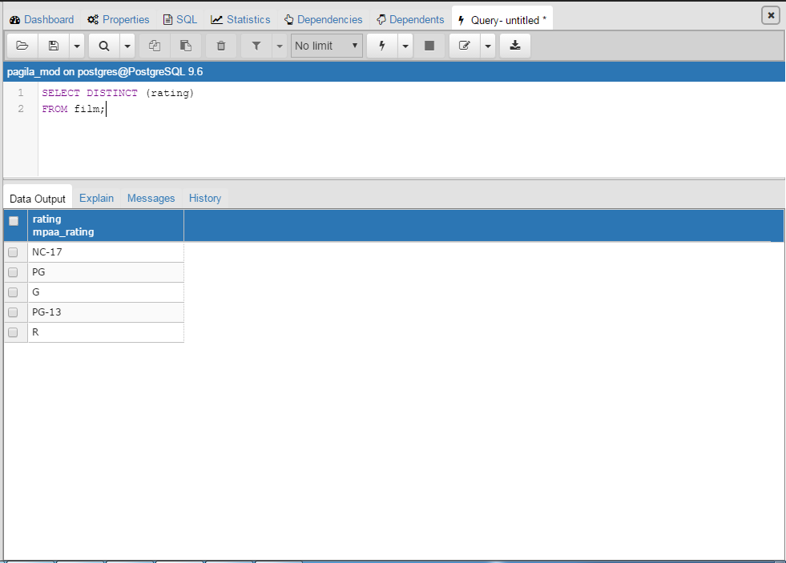
Solutions (cont’d)
3.

Slide 71
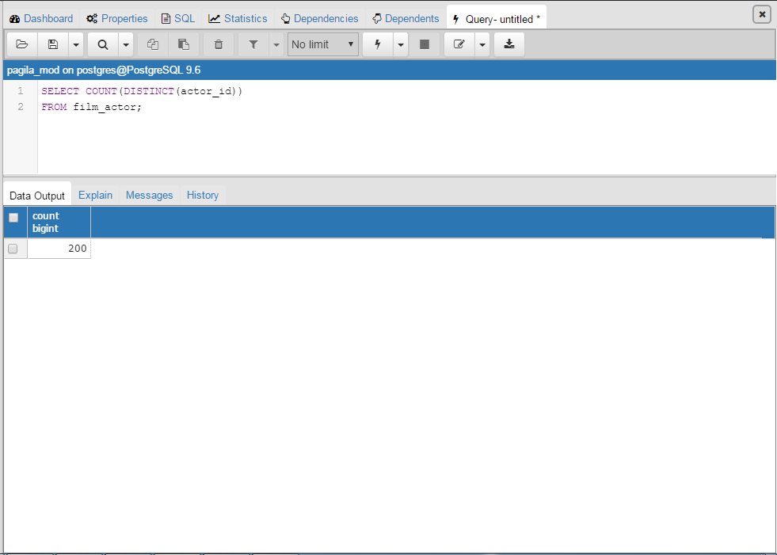
Solutions (cont’d)
4.

Slide 72
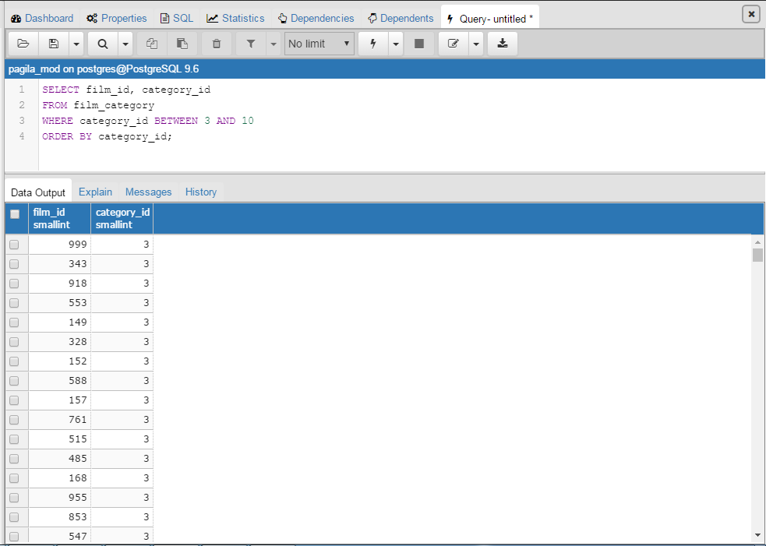
Solutions (cont’d)
5.
Notes:
Potential question: Why was 3 and 10 brought in?
Answer: Because BETWEEN is inclusive.

Slide 73
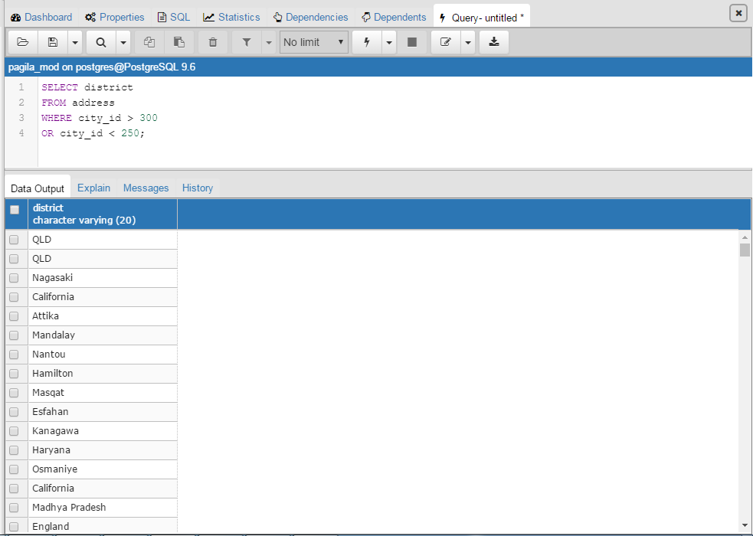
Solutions (cont’d)
6.

Slide 74
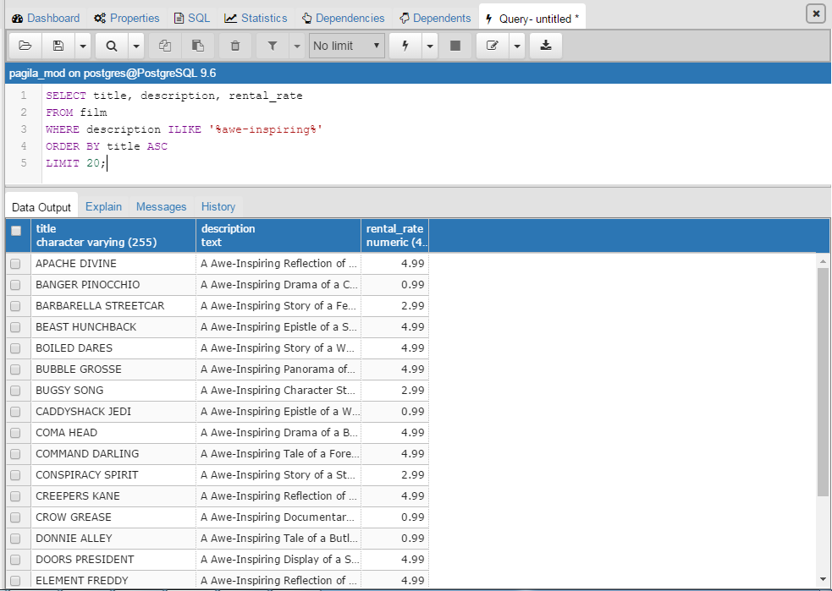
Solutions (cont’d)
7.
Notes:
ASK STUDENTS: Why ILIKE?
ANSWER: Because it is case-insensitive. If caps is not important, this better ensures we capture all the instances of awe-inspiring.
Also, notice the single quotes – double quotes doesn’t work (unlike Python and other programming languages). You need to start noticing and internalizing these subtleties.

Slide 75
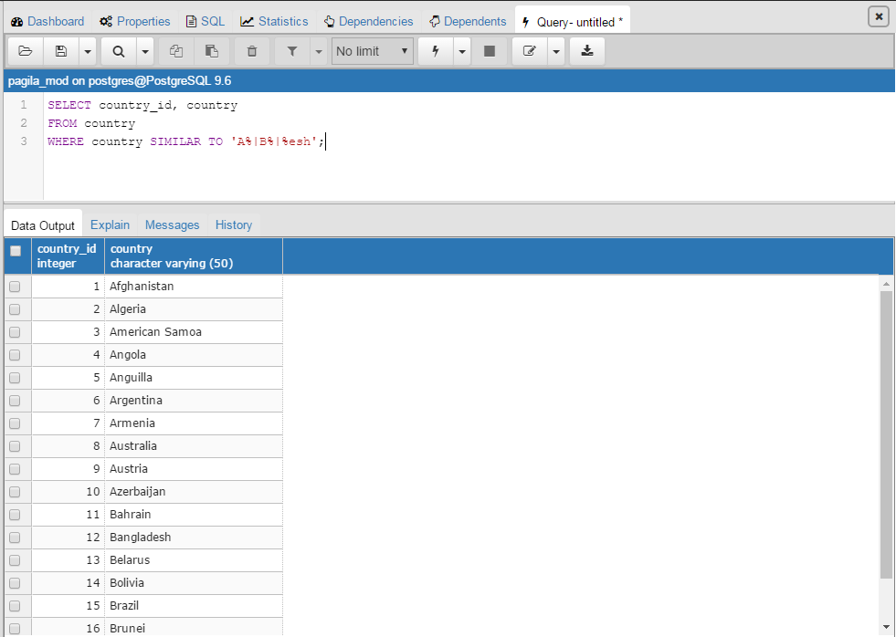
Solutions (cont’d)
8.
Notes:
SIMILAR TO is used for multiple pattern matching. Can also use ILIKE in combo with ORs.
The bigger learning here is that you won’t know how to do everything in SQL after this course – even reading data. That’s because there are so many different functions. But, the answer is written and between SQL and PostgreSQL support websites, there is a very strong chance that someone somewhere has tried to do what you are trying to do. So, Google search and read through answers and try things out! You won’t break your computer (most of the time)! The truth is that is exactly how we structured this problem. None of us had done this before in practice.

Slide 76
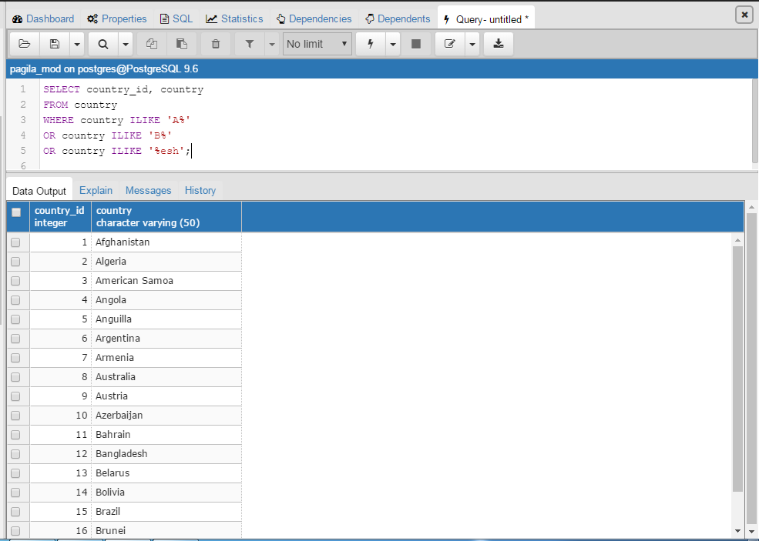
Solutions (cont’d)
8. (alternate)
Notes:
SIMILAR TO is used for multiple pattern matching. Can also use ILIKE in combo with ORs. But, SIMILAR TO is simpler and therefore more superior.
The bigger learning here is that you won’t know how to do everything in SQL after this course – even reading data. And, there are multiple ways to accomplish the same task just like in excel. That’s because there are so many different functions. But, the answer is written and between SQL and PostgreSQL support websites, there is a very strong chance that someone somewhere has tried to do what you are trying to do. So, Google search and read through answers and try things out! You won’t break your computer (most of the time)!

Slide 77
AGGREGATE FUNCTIONS
Mainly used with GROUP BY (discussed shortly) but can be used on their own too.
Main aggregate functions: ROUND (aggregate_function, n), AVG, MIN/MAX, SUM, COUNT (discussed earlier)
ROUND → rounds results of an aggregate function to a desired number of decimals
Notes:
Mention this will make more sense in just a bit when we do some examples together.
ASK STUDENTS: What are some data type limitations with these aggregate functions?
ANSWER: Can you do a min/max or average on a string? No! So, data needs to be integer, float, or a number of some sort.

Slide 78
AS
A way to rename columns with an alias.
SELECT id, price AS house_cost
FROM main_home;
Notes:
Really useful trick when tables have many columns it becomes hard to understand what they all mean.
We can also mention that we are able to build an alias for a table, which will be covered in the next section.

Slide 79
GROUP BY
Groups the relevant rows from SELECT statement together
You need to select all columns in SELECT in GROUP BY or you will receive a syntax error
Often used with aggregate functions
SELECT yr_built, COUNT(yr_built) AS number_built
FROM build_info
GROUP BY yr_built;
Notes:
ASK STUDENTS: What does this query do?
ANSWER: It returns how many houses were built in each year.

Slide 80
HAVING
Used with GROUP BY to filter rows that have a specified condition.
HAVING vs. WHERE
HAVING → after GROUP BY
Sets the condition for groups after GROUP BY
Filters groups
WHERE → before GROUP BY
Sets the condition for rows before GROUP BY is applied
Filters rows and applies to all of them

Slide 81
HAVING (cont’d)
SELECT yr_built, COUNT(yr_built) AS number_built
FROM build_info
GROUP BY yr_built
HAVING yr_built BETWEEN 1980 AND 2000;
SELECT yr_built, COUNT(yr_built) AS number_built
FROM build_info
WHERE yr_renovated != 0
GROUP BY yr_built;
SELECT yr_built, COUNT(yr_built) AS number_built
FROM build_info
WHERE yr_renovated != 0
GROUP BY yr_built
HAVING yr_built BETWEEN 1980 and 2000;
Notes:
ASK STUDENTS: What does query 1 do?
ANSWER: First groups the rows by year built. Then it only returns the groups between and including 1980 and 2000
ASK STUDENTS: What does query 2 do?
ANSWER: First only returns the rows where houses were renovated. Then out of the remaining results, it groups by yr_built.
ASK STUDENTS: What does query 3 do?
ANSWER: First, it only returns ROWS of houses that have been renovated. Then out of the returned rows, it GROUPS them by yr_built. Then out of the grouping results, it only RETURNS THE GROUPS that were built between and including 1980 and 2000.

Slide 82
SQL Exercises III
Exercises:
Open up the Query Tool in pagila_mod database and create the following:
SELECT the cities WHERE the country IDs are BETWEEN and including 75 and 100. Return respective city IDs too.
In the city table, return the country ID and number of each country ID. And, ORDER BY country_id in ascending order and LIMIT to 10.
Return the mean rental duration of the films.

Slide 83
SQL Exercises III (cont’d)
4. Return the film IDs, description, and rental rates of films with the minimum rental rates.
5. Rename the last update column in the film category table to “last_online.” Return just that renamed column.
6. In the inventory table, for the first 50 inventory IDs, group by store ID, and count the number in each store. Return store ID and the count. Rename the count column to “total”.

Slide 84
SQL Exercises III (cont’d)
7. ADVANCED: In the film category table, for the film IDs that are greater than 20 and less than 50 (inclusive of 20 and 50), group the results by category ID between 5 and 10 (inclusive), and count each group. Rename the count column to “total”. Order the groupings in ascending order. Return the category IDs and counts.

Slide 85
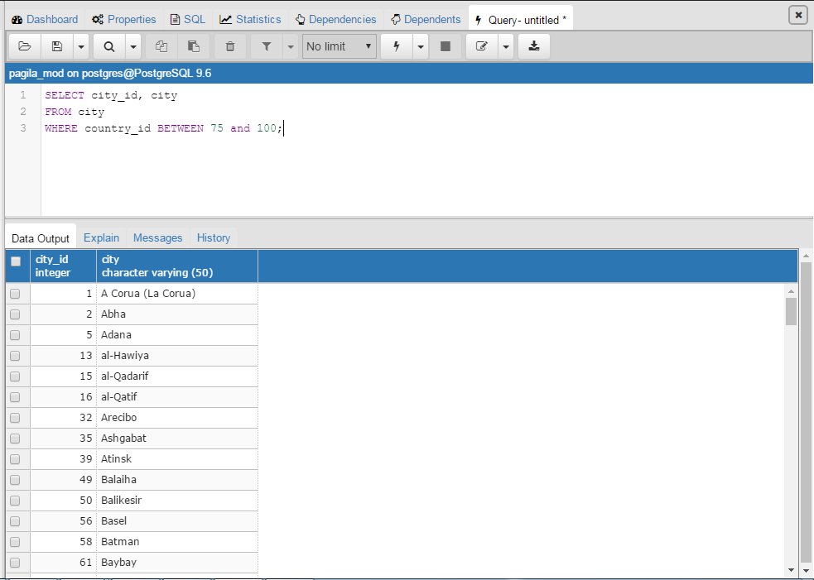
Solutions
1.

Slide 86
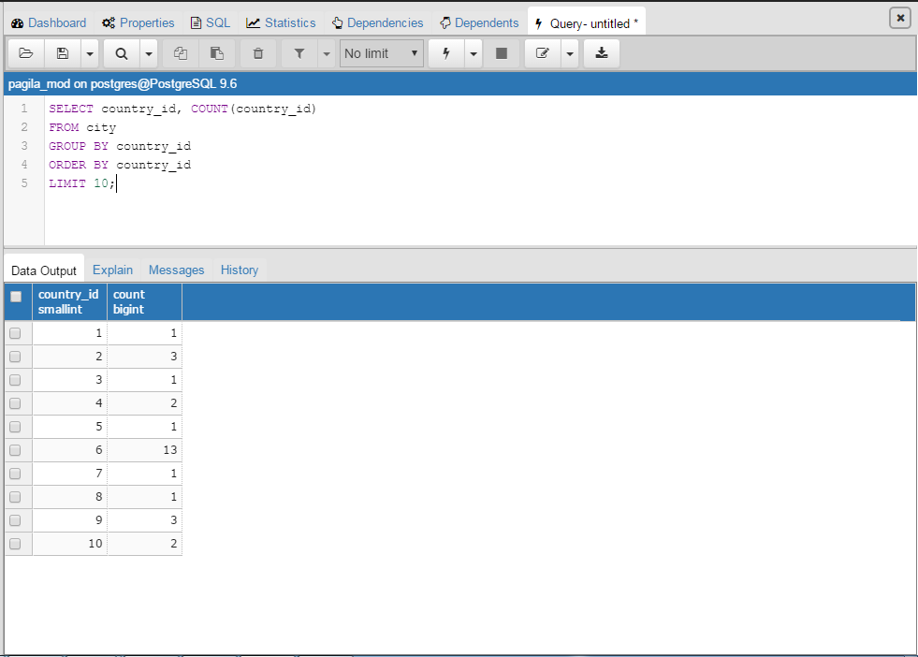
Solutions (cont’d)
2.

Slide 87
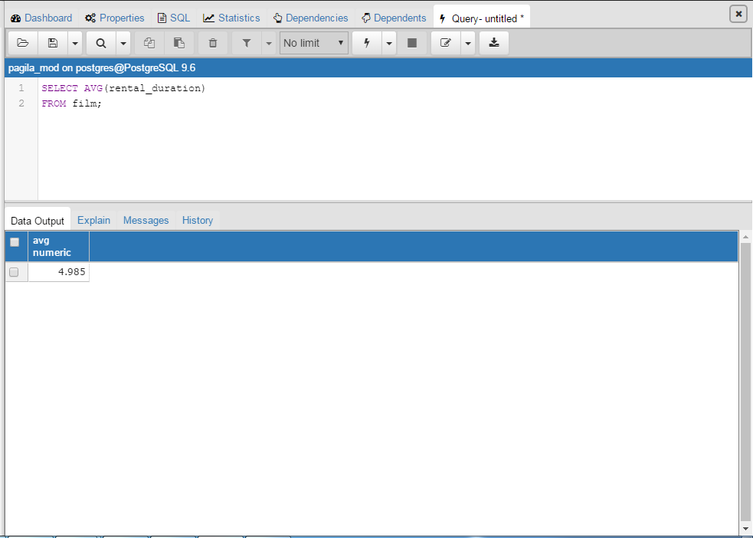
Solutions (cont’d)
3.

Slide 88
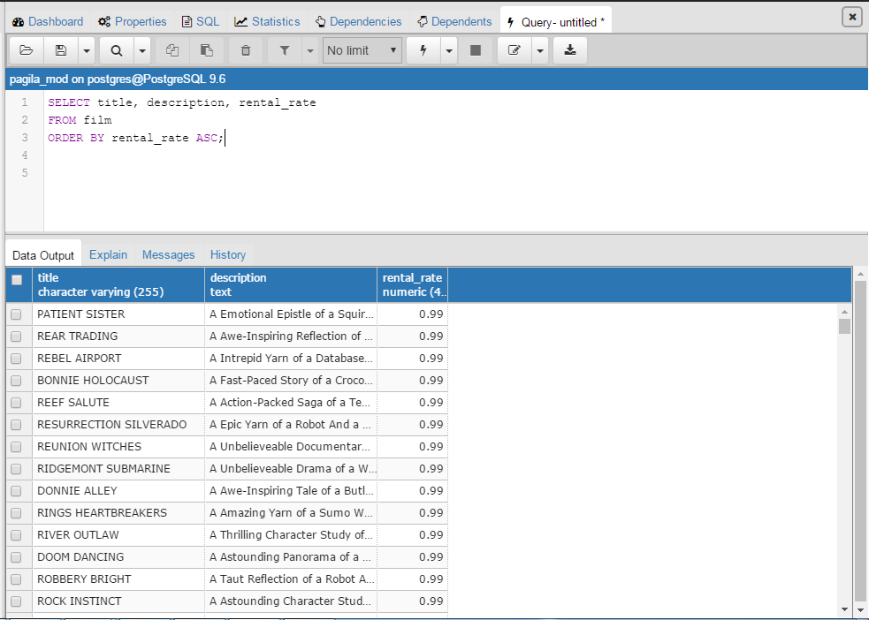
Solutions (cont’d)
4.

Slide 89
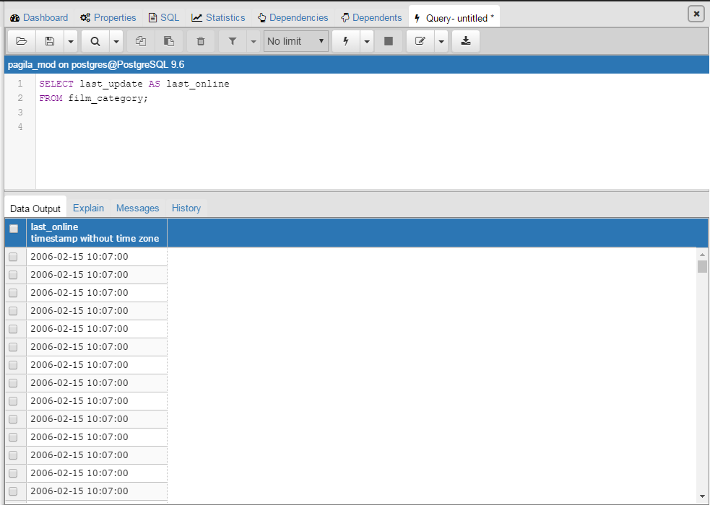
Solutions (cont’d)
5.

Slide 90
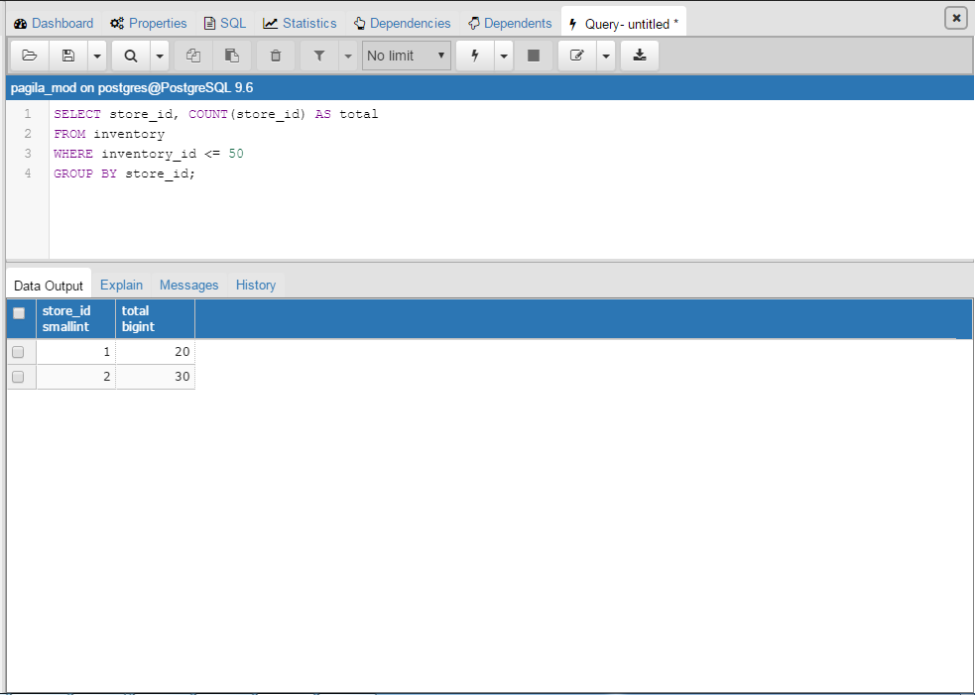
Solutions (cont’d)
6.

Slide 91
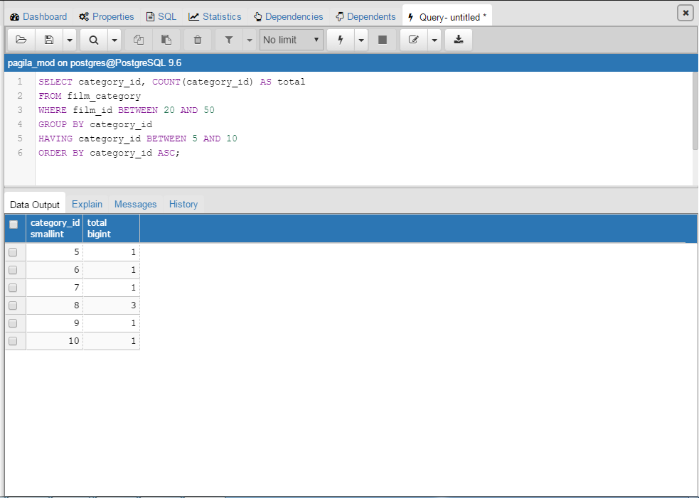
Solutions (cont’d)
7.

Slide 92
Section Recap: What Have We Learned?
SUMMARY
Loading Data / Databases
Cognitir’s Trifecta SQL Query-Building Method™
SQL Syntax
Debugging
Query Tips & How to Become a SQL Ninja
PostgreSQL Data Types
Comments
Most Important SQL Commands

Slide 93
BEYOND THE BUILDING BLOCKS

Slide 94
Section Overview
OVERVIEW
Query Multiple Tables: Joins
Joins (3 or more tables) (More advanced)
Subqueries
Notes:
Joins 3+ will not be covered in-depth unless time exists.
Subqueries II will most likely be “additional practice” that students can work through – similar to subqueries with some more challenging practice.

Slide 95
Query Multiple Tables: JOINS
A JOIN allows us to combine columns from multiple tables and store them into a single set of information.
We JOIN tables together by connecting Primary Keys (PK) and Foreign Keys (FK).
Notes:
One of the most powerful tools within relational databases is the JOIN.
In business, we often will need to aggregate information from various tables and combine together.

Slide 96
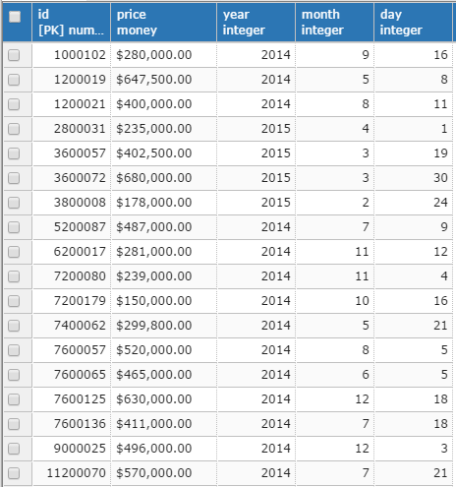
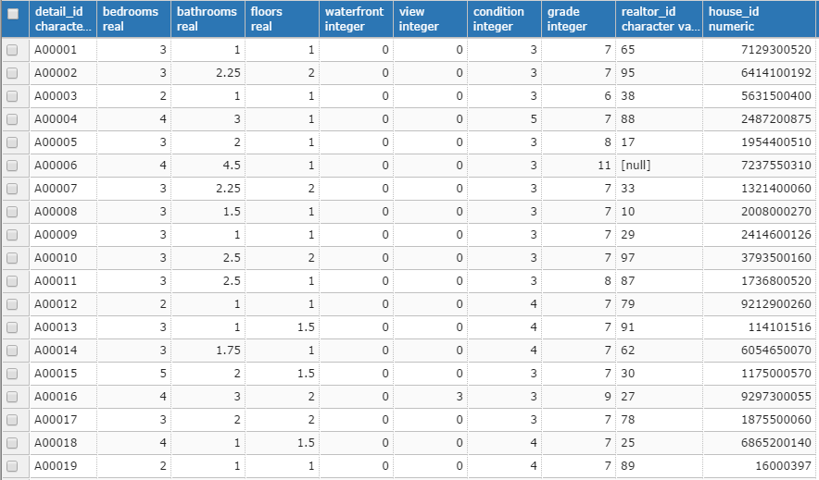
Query Multiple Tables: JOINS (cont’d)
Conceptual Overview: Housing Database
Connect on PK & FK
Main HomeTable
House_Details Table
Notes:
PK has to be unique
Reminder that students can right click a table and look at properties – this is a good place to show them that.

Slide 97
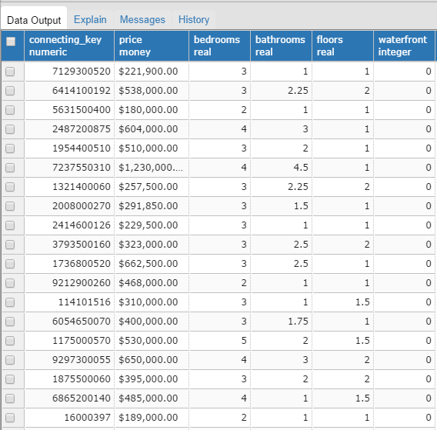
Query Multiple Tables: JOINS (cont’d)
Conceptual Overview: Housing Database
We have combined info from both tables based on the house_id
Notes:
We now can see each ordered along with info from both tables. In this example, a join was performed to combine these tables and an alias was used to rename house_id to connecting_key
Reminder that code will be looked through after concept is explored!
This is NOT A UNION: This is filling in data based on shared information, anything that did not connect via the PK/FK relationship will not be stored in this set.

Slide 98
Query Multiple Tables: JOINS (cont’d)
Why not store all data in our database as a single table?
Normalization would not be possible.
Slow querying would occur with massive datasets.
Hard to see the groups of data that exist if we have a singular table.
A JOIN provides a simple way to combine tables, while aligning with relational database expectations (normalization, efficiency, etc..)
Notes:
The idea of normalization is that we do not repeat data, making it easier to add/modify/delete data and just interpret.
It is very possible to have a database hosted that holds trillions of rows of data….it will take a long time to go through every single row, where multiple tables and joins allow you to be selective in which tables / information you actually are going to use.
It is helpful to have some data as customers, some as transactions, some as specific store, etc.. just for our own interpretation of how the data is connected.

Slide 99
Query Multiple Tables: JOINS (cont’d)
Cognitir Strategy For Joins:
Draw out a Venn diagram of tables of interest.
Identify the information you want: What columns do you need to meet your business objective?
Determine which type of join you need: inner, outer, left, right?
Write the appropriate code.
Notes:
This can be referenced quickly as a potential strategy – maybe better to push once students have seen examples (98-100)

Slide 100

INNER JOIN
Used to join multiple tables
Allows us to combine rows from two or more tables based on a shared value (or shared values)
Notes:
This is a very popular command in all databases. Allows us:
Find all orders placed by a specific customer.
Print out stock information from multiple markets, adhering to a specific time interval.
Gather summary statistics across multiple tables.

Slide 101
INNER JOIN (cont’d)
Let’s start by doing an inner join
for house_details and main_home:
INNER JOIN: Command for adding table to connect with.
ON: Provides the id to connect two tables
Need to have a Foreign Key built for a join.
Need to specify table then add key: table1.unique_id = table2.unique_id
SELECT *
FROM house_details
INNER JOIN main_home
ON house_details.house_ids = main_home.id;
Notes:
Ask students what they expect to get?
Ask them how they can avoid producing ALL columns?
Output: This will join all columns where there is a shared house_id across both tables
Image: http://www.w3schools.com/sql/sql_join_inner.asp
They do not need to use: table1.unique_id = table2.unique_id in this example since the variables connecting are different, but it is a good habit to build because people tend to reuse variable names (especially things like customer id)

Slide 102
INNER JOIN (cont’d)
Same inner join for house_details & main_home but specify the desired
columns.
We can use ORDER BY, WHERE, etc.. in JOINS too!
SELECT bedrooms, floors, grade AS rating, price, house_ids
FROM house_details
INNER JOIN main_home
ON house_details.house_ids = main_home.id
ORDER BY price DESC;
Notes:
Notice that we did not specify the tables for each column: Only necessary if two tables have the same column name.
Expected output: now we will only receive output for bedrooms, floors, rating, price, house_ids where each table has a match house_id
We also are ordering by price from those houses that are pulled in the inner join in a DESC order (we could use ASC to change order)
Image: http://www.w3schools.com/sql/sql_join_inner.asp
They do not need to use: table1.unique_id = table2.unique_id in this example since the variables connecting are different, but it is a good habit to build because people tend to reuse variable names (especially things like customer id)

Slide 103
INNER JOIN (cont’d)
Same inner join for house_details & main_home with a Table Alias.
Instead of typing out house_details and main_home, we can just call a table alias:
table_alias.column_name
SELECT bedrooms, floors, grade AS rating, price, house_ids
FROM house_details h
INNER JOIN main_home m
ON h.house_ids = m.id
ORDER BY price DESC;
Notes:
Instructor: Remind students of AS statement referenced earlier
The table alias is a more efficient way to reference a table and can save time in larger queries.
Output: Same output as before, the major difference is we are being more efficient by using a table alias.
http://www.w3schools.com/sql/sql_join_inner.asp
They do not need to use: table1.unique_id = table2.unique_id in this example since the variables connecting are different, but it is a good habit to build because people tend to reuse variable names (especially things like customer id)

Slide 104
INNER JOIN Exercises
Exercises:
Open up the Query Tool in pagila_mod database and create the following:
Create an INNER JOIN statement that joins city with country and prints out all columns.
Create an INNER JOIN statement that joins film with language and prints: film_id, rental_rate, release_year, and language.
Create an INNER JOIN statement that joins film to film_actor. Only include: title, rental_rate, description, rental_duration, rating, and actor_id.
Notes:
Students should focus on problems 1-3

Slide 105
INNER JOIN Exercises (cont’d)
ADVANCED: Create an INNER JOIN statement that provides information on all of the films at store 2. Include information on title, description, inventory id, and rating.
ADVANCED: Create an INNER JOIN statement that counts the total number of cities in each country. Rename the count to “total_cities”. Sort the results by countries with maximum amount of cities to least amount of cities.

Slide 106
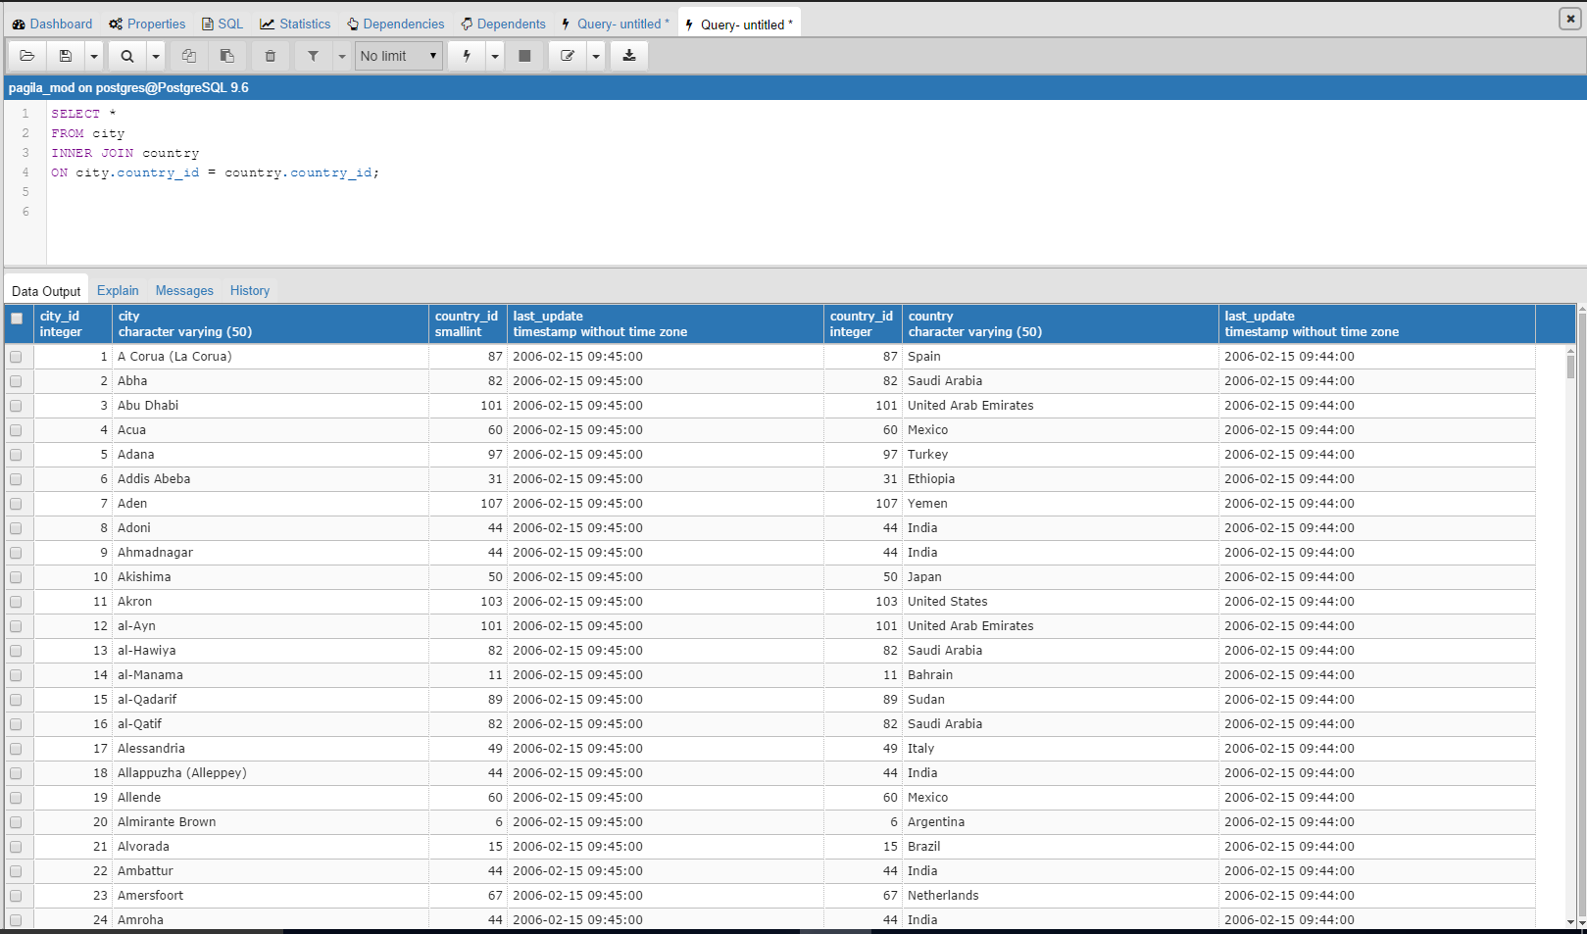
INNER JOIN Solutions
1.
Notes:
Must specify which table is referenced since country_id is in both.
ASK STUDENTS: Why can’t I INNERJOIN on timestamp?
ANSWER: It isn’t unique – they are all the same. Also not stored as a PK/FK
ERROR: column reference "country_id" is ambiguous
LINE 4: ON country_id = country_id;
^

Slide 107
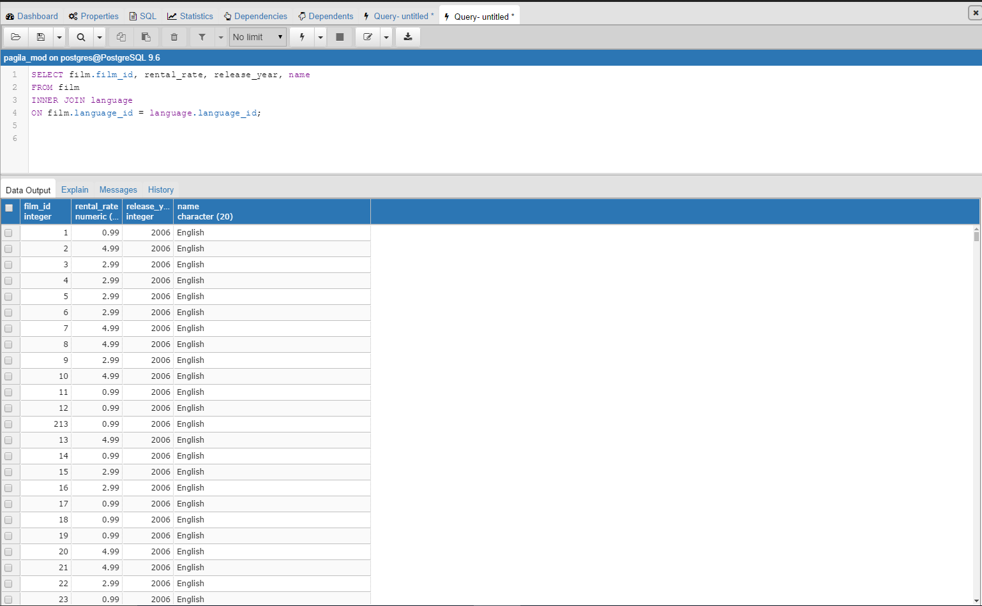
INNER JOIN Solutions (cont’d)
2.
Notes:
Hint: Matching column names can assist with finding PKs

Slide 108
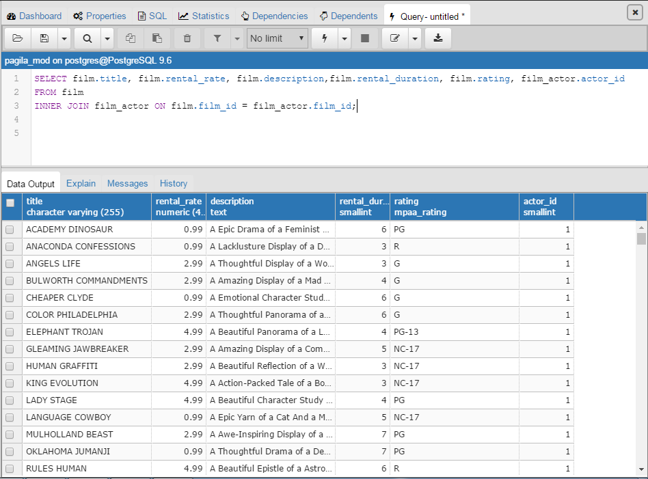
INNER JOIN Solutions (cont’d)
3.
Notes:
Question: Why might this not be the best way to write this if I plan to SHARE it?
Answer: INNER JOIN…..ON all on same line. Can make it tough to read.
Question: Why did we add the table name this time?
Answer: Just to show it works – was not required.

Slide 109
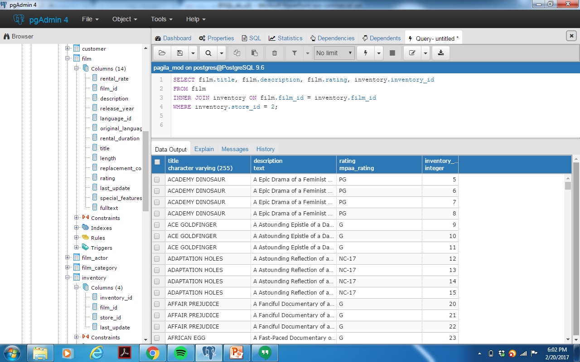
INNER JOIN Solutions (cont’d)
4.
Notes:
Students need to first determine which tables to join based on requested information.
Where statement is going to filter so we only receive Store_id 1.
Notice our use of long form notation. Just another way to do it.

Slide 110
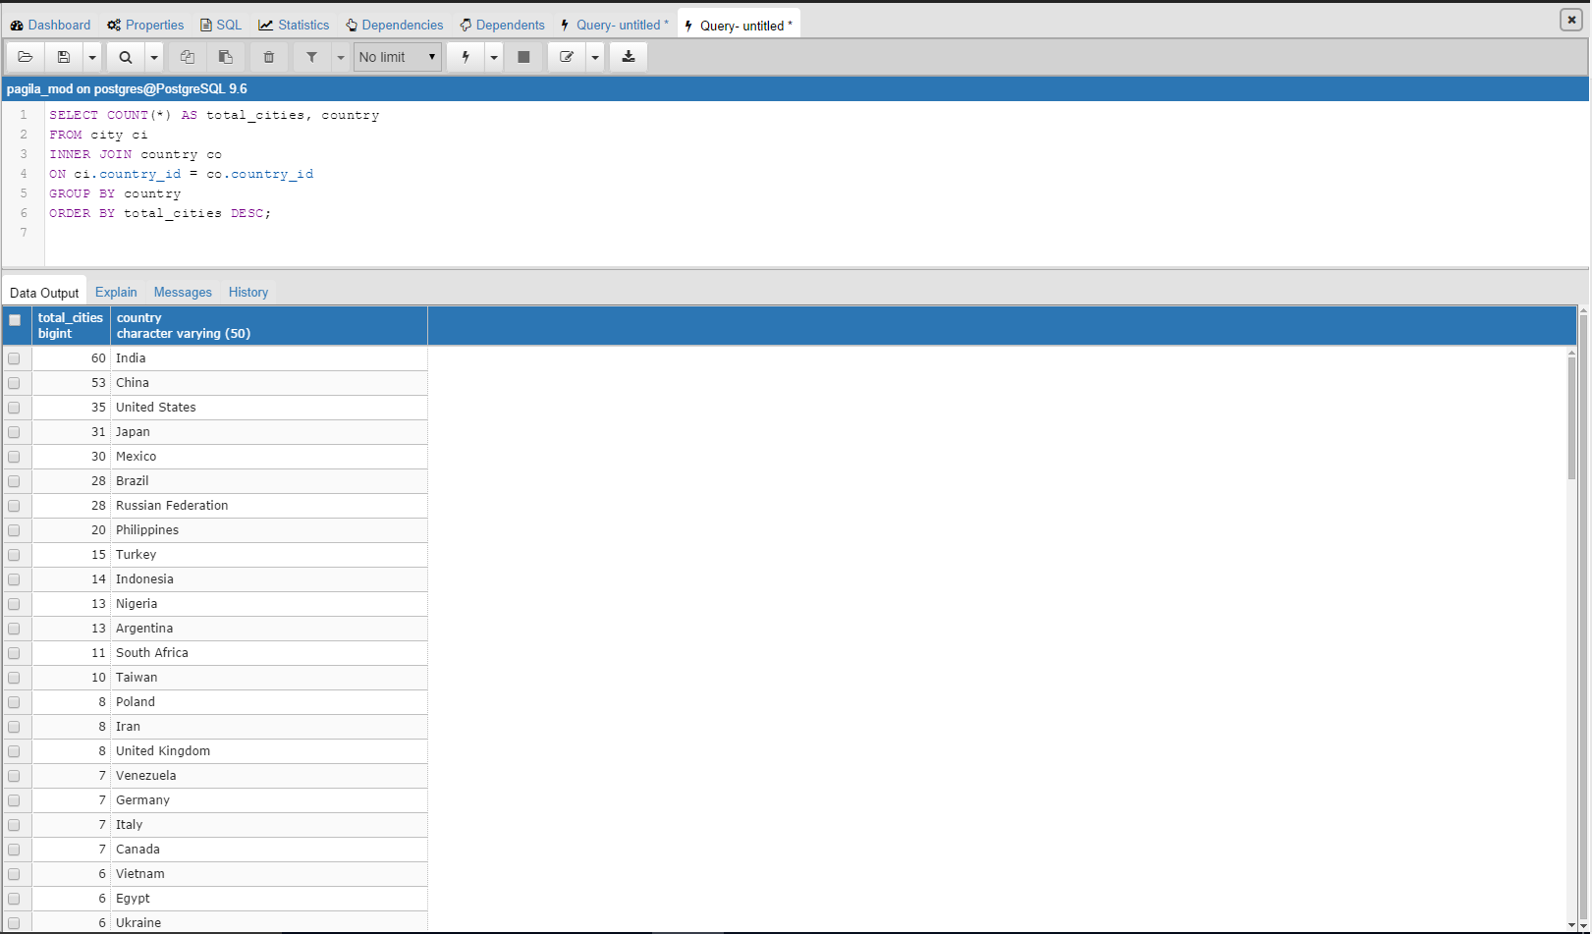
INNER JOIN Solutions (cont’d)
5.
Notes:
GROUP BY is going to allow us to COUNT total rows that exist per country once we join CITY and COUNTRY
We can then just use our ORDER BY statement

Slide 111
INNER JOIN (cont’d)
We can use GROUP BY to
provide summary information.
There are NULLS within location_table, so the INNER JOIN allows us to only count those areas that have data.
SELECT ROUND(AVG(grade),3) AS mean_rating, COUNT(*),zipcode
FROM house_details h
INNER JOIN location_table l
ON h.house_ids = l.house_id
GROUP BY zipcode
ORDER BY mean_rating DESC;
Notes:
This will produce an output of mean_rating (from Grade), count of houses all grouped by zipcode.
House_details didn’t have zip code info. But now we can use INNER JOIN and connect location_table to retrieve zip code information.
Important to reiterate that a join still lets us use all of the other SQL commands (SELECT, WHERE, ORDER BY, GROUP BY, etc.).
ROUND(X,#) is the formula for rounding a numeric type to a certain number of decimal places. Similar to what they would see in Excel.

Slide 112
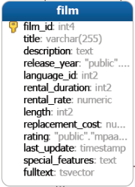
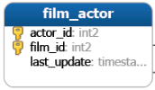
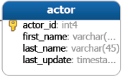
INNER JOIN 3+ Tables
Oftentimes we have a table that is used to connect two other tables.
These tables could be called associative tables or junction tables.
In pagila_mod the table film_actor is a junction table for the tables film & actor.
Images from: http://www.postgresqltutorial.com/postgresql-sample-database/
Notes:
The point of this slide is to create the mindset that two joins is often not enough to get the data you want in a normalized database. The next slide will introduce the syntax necessary for this.
This is similar to the normalization example used before. In this example we are able to store actors separate from films, so we don’t need to repeat values if two different actors work in the same film. Or, if the same actor works in multiple films.
Images from: http://www.postgresqltutorial.com/postgresql-sample-database/
Important point: The PK for film_actor is just a combination of film_id and actor_id, the FKs are actor_id and film_id

Slide 113
SUBQUERY
Another powerful tool in relational databases is the use of the subquery.
A subquery allows you to code a SELECT statement within another set of SQL code.
This kind of query is often used to produce a summary metric to use in additional SQL code.
Notes:
The subquery could occur within the SELECT, HAVING, FROM, or WHERE statement.
Example could be needing to use an average value, but rather than writing two different queries you contain it all in one.

Slide 114
SUBQUERY (cont’d)
Main use of subquery is efficiency.
In real-life massive datasets have to be pushed to servers where querying takes a long time. Reduction of steps = increased productivity.
Notes:
We can convert a two-step SQL statement into a one-step statement.
Oftentimes we are going to pushing SQL statements out on a server, and as size of data increases so does the time needed to process.
Having to do two-steps for some code can really slow us down and decrease overall productivity.

Slide 115
SUBQUERY (cont’d)
Let’s print house details for all houses below the average price.
We first write a query for AVG price:
Now, we can write this value into our code:
Subquery makes this much quicker.
SELECT AVG(price::numeric)
FROM main_home;
SELECT *
FROM main_home
WHERE price::numeric < 540623.6140138085;
Notes:
Teaching point: For price type in PostgreSQL we need to cast to numeric (per the example code) – this is covered in debugging.
There are methods of storing a variable, but they aren’t done in pgadmin, rather in psql (command line)
More info: http://stackoverflow.com/questions/14261035/user-defined-variables-in-postgresql/14261927#14261927

Slide 116
SUBQUERY (cont’d)
Let’s print house details for all houses below the average price.
We can create a separate SELECT & use it in our WHERE statement.
Subquery makes this a one-step query.
SELECT *
FROM main_home
WHERE price::numeric < (SELECT
AVG(price::numeric)
FROM main_home);
1. Subquery
2. Outer Query
Notes:
SQL begins by reading the SELECT statement subquery, and then using that value in the outer query.
Teaching point: For price type in PostgreSQL we need to cast to numeric (per the example code)

Slide 117
SUBQUERY (cont’d)
Let’s print house details only for those houses renovated in 1990.
Our subquery identifies those houses renovated in 1990 from build_info table.
The IN operator is then used to only pull information for these select houses from house_details.
We first created a list of houses renovated in 1990, and then SELECTED information about them and ORDERED by grade.
SELECT *
FROM house_details
WHERE house_ids IN (SELECT house_id
FROM build_info
WHERE yr_renovated = 1990)
ORDER BY grade DESC;
Notes:
Remind students that the subquery is run first, and is just used in this case like any set of values when using IN operator.
First describe to students how the SELECT statement works: It will provide a list of house_ids when house was renovated.
Then show how we use this in the IN statement to pull house_details.
To print the list (if you want to reference):
SELECT house_id
FROM build_info
WHERE yr_renovated = 1990;

Slide 118
SUBQUERY Exercises
Exercises: Open up the Query Tool in pagila_mod database and create the following:
Create an INNER JOIN statement that joins film & film_actor. Print out the actor_id & film_id for films with a rental rate above $2.99.
Create a SUBQUERY from the film table to only select film ids for films with a rental rate above $2.99. Create an OUTER QUERY that prints out actor_ids and film_id from the film_actor table for those films that meet the criteria (Hint: Use WHERE and IN).
Notes:
Have students focus on problems 2-3. Problem 1 is the same as 2.
This first question is important to show that at ties JOINS and SUBQUERIES can be similar
2 should be fairly easy and just require students to look back at prior slides

Slide 119
SUBQUERY Exercises (cont’d)
Create a SUBQUERY for film that prints out the title, release year, & length for films with length greater than the average length. Sort in ascending order of length.
Advanced: Create a SUBQUERY that provides the customer ids for all customers with more than 30 rentals. Then use an OUTER QUERY to print out the first name, last name, and email for these valuable customers. ORDER BY last name (starting at the end of the alphabet).

Slide 120
SUBQUERY Exercises (cont’d)
Advanced: Create a SUBQUERY that is an INNER JOIN of inventory and store. This subquery should produce a list of films offered at store 1. Provide the film title, description, rental rate, release year, and rating. Only show films with a G rating.

Slide 121
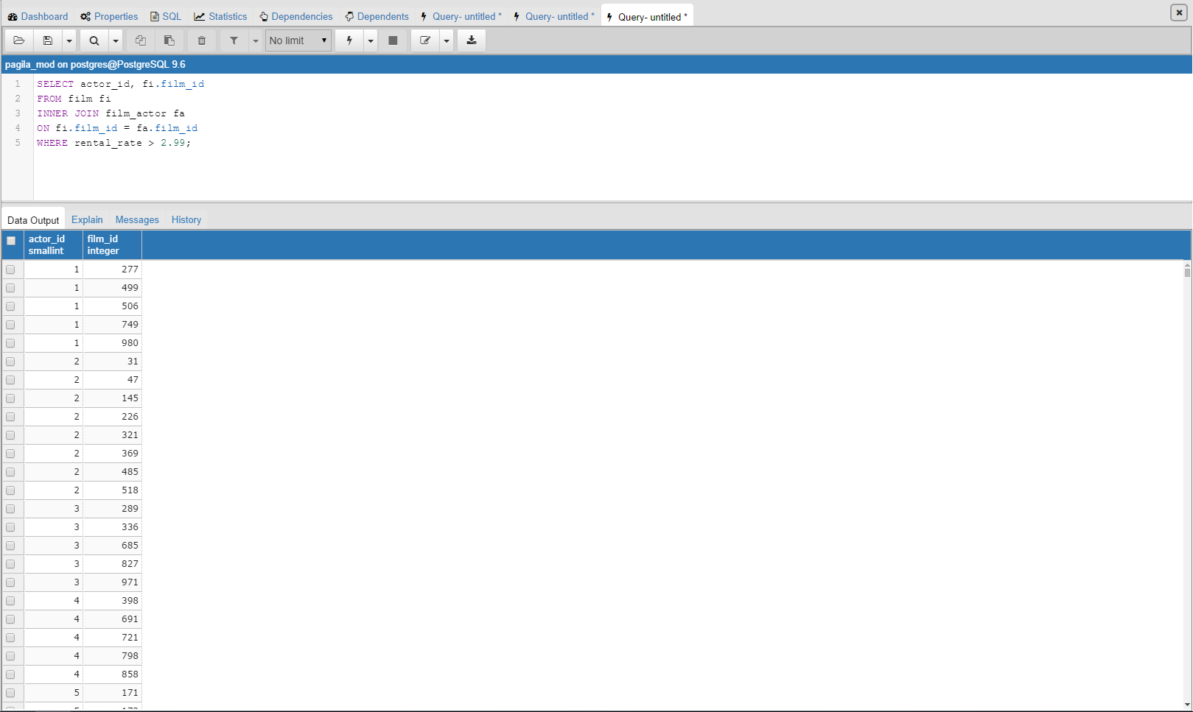
SUBQUERY Solutions
1.
Notes:
1. We only print out those actors in movies with greater than $2.99

Slide 122
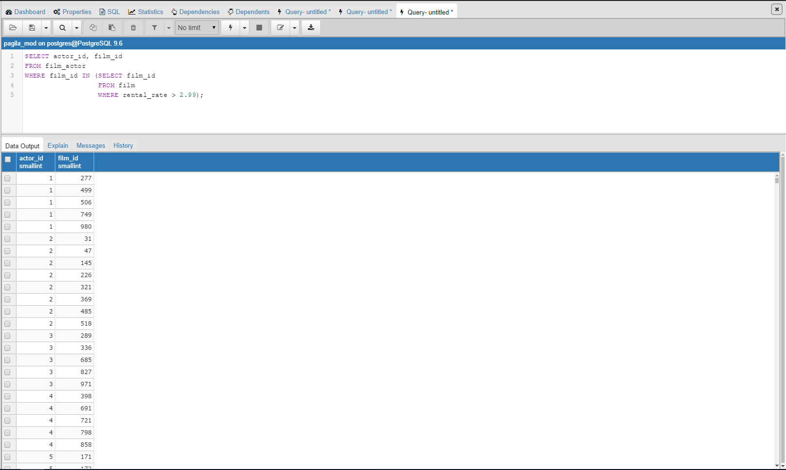
SUBQUERY Solutions (cont’d)
2.
Notes:
2. We get the same information (will discuss this later, but main point is sometimes joins spit out the same info as subquery)

Slide 123
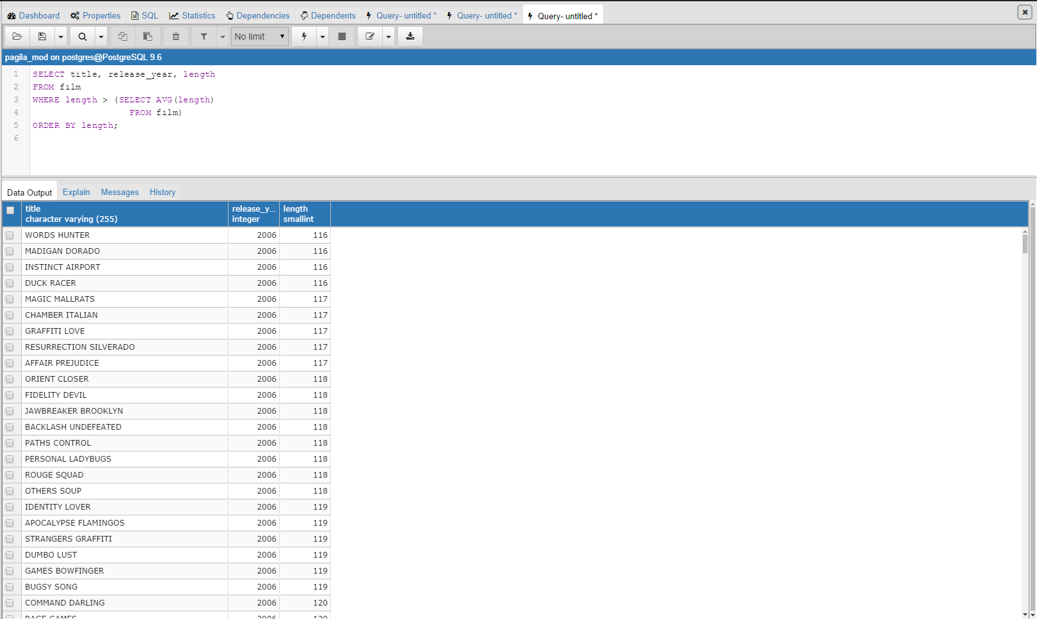
SUBQUERY Solutions (cont’d)
3.
Notes:
Average Film length = 115.272

Slide 124
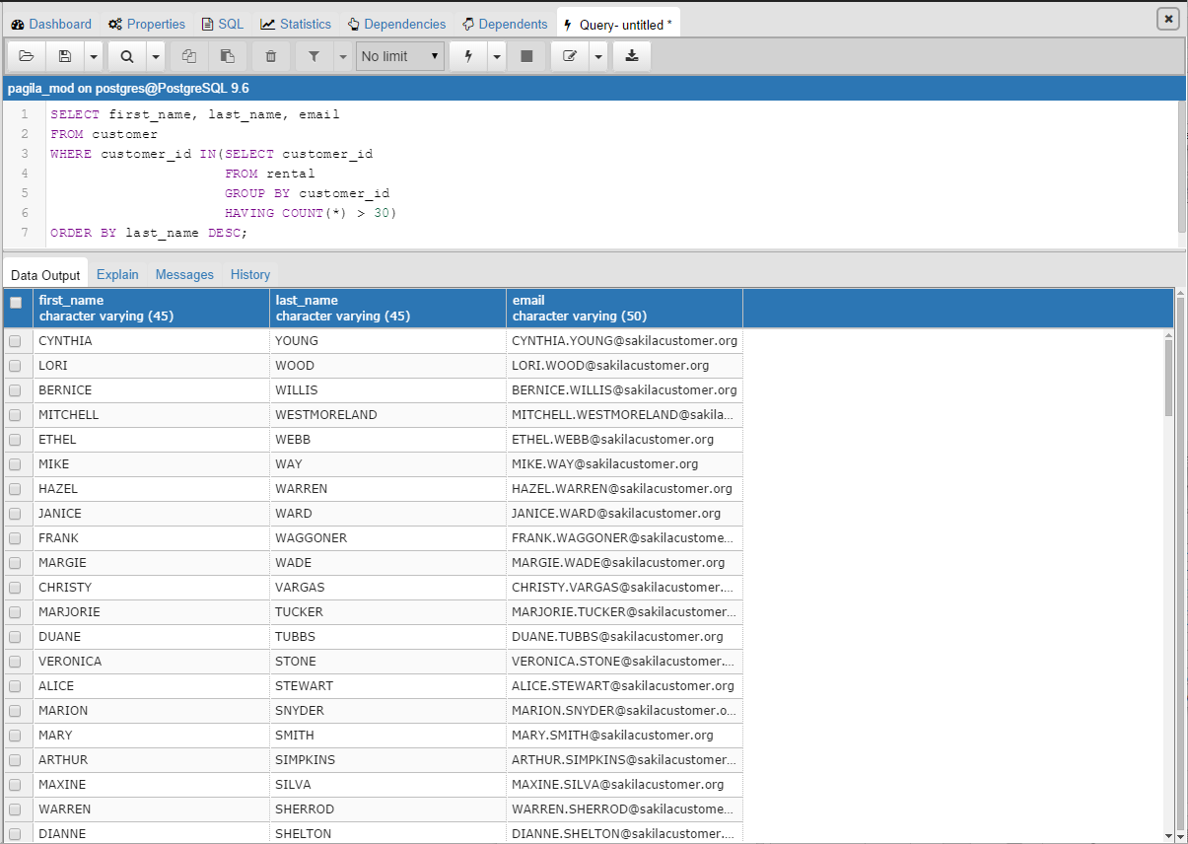
SUBQUERY Solutions (cont’d)
4.
Notes:
Average Film length = 115.272

Slide 125
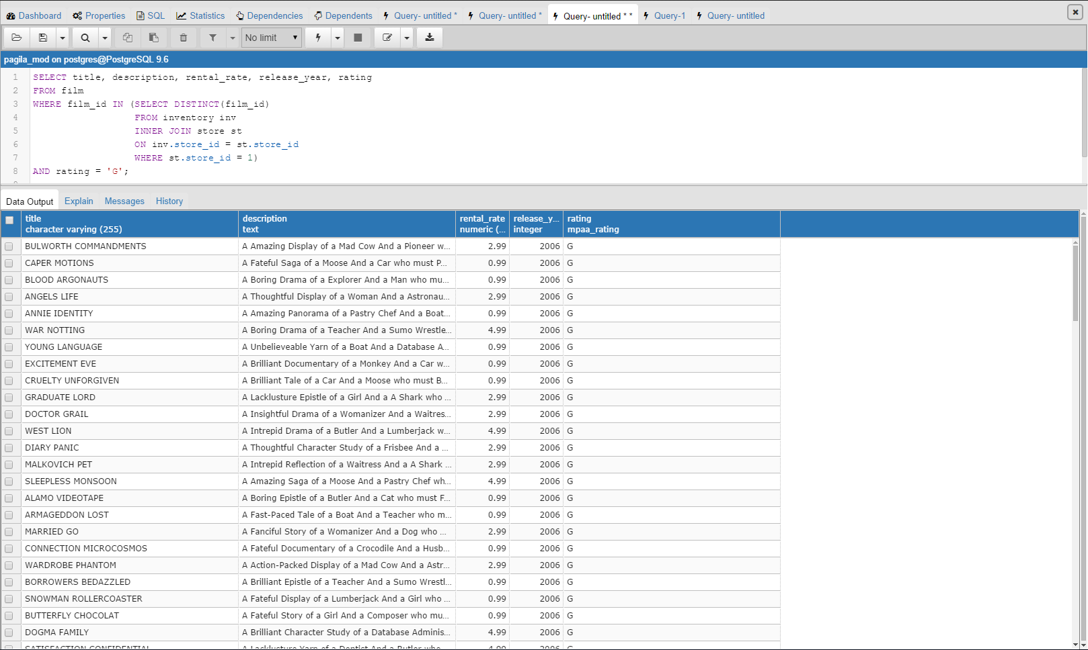
SUBQUERY Solutions (cont’d)
5.
Notes:
This seems tricky, but is pretty straightforward: The inner join just will product the film ids for those films stored at a specific store.
From there, we can use the WHERE statement and IN to get the additional information.

Slide 126
SUBQUERY
Sometimes we can use a JOIN or SUBQUERY. How do we make a decision?
The distinction will become clearer with experience, but here are some tips:
JOIN | SUBQUERY
Retrieve multiple columns from multiple tables. | Calculate a summary value to use in a query. (i.e Average, Max, Min)
Often better performance (think time). | Query for a set of values (i.e. customer ids, film ids, range of years, etc..)
“Combine info from Table 1 with Table 2.” | “Get info from Table 1 based on X information.”
Notes:
Processing time is another consideration that could be discussed, but does not seem important to an introductory course:
More here = http://stackoverflow.com/questions/2577174/join-vs-sub-query

Slide 127
Section Recap: What Have We Learned?
SUMMARY
Query Multiple Tables: Joins
Joins (3 or more tables)
Subqueries

Slide 128
IN-CLASS PROJECT

Slide 129
Project Directions
This project will simulate real-life, “on the job” SQL query building.
You will 1 hour to complete the project then we will go over the solutions.
Tips:
There will be many ways to solve each problem – just solve it!
Remember to use the ER Diagram to understand table relationships.
Print this out if you have not done so already (next slide)
Use the Cognitir Trifecta SQL Query-Building Method™.
Work with a partner or in small teams.
Use the cheat sheet we provided for quick SQL command references.
Remember, stackoverflow.com and PostgreSQL documentation may come in handy too!
Most importantly, have fun!

Slide 130

Project ER Diagram
Notes:
Mention that students should print this if they have not done so already
ER Diagram can be helpful in identifying columns we need. Also should mention within each table we can access information about columns. Right click -> Properties shows us PK/FK
For students: Helpful to add a one sentence snippet on each table as they work through.

Slide 131
Project Exercises
Exercises: Open up the Query Tool in northwind database and create the following queries:
You are asked to provide an inventory report for a client. The report should include product name, stock information, supplier id, unit price, units on order & reorder level. For this report only include products that are still available (those not available are marked with a ‘1’ under discontinued).
Which type of discount was most frequently given? Produce a table set showing the frequency of each type of discount provided.
(i.e., How many times was discount of 0, 0.05, etc.. applied?)
Notes:
Hints:
1) Need to FILTER (where) out any discontinued products
2) We need a COUNT of all of this information. What do we want? We want discounts, so find the table with discounts.

Slide 132
Project Exercises (cont’d)
How many unique customers have made a purchase in our system?
Among these customers that have at least one purchase we wish to target our most active shoppers for our “Northwind Loyalty Program”, a program that sends special offers, coupons, and event information. If we want the top 9 active customers, who (customerids is fine for now) should we choose?
Notes:
3) HINTS: Unique indicates that we don’t do repeats; purchase means we need to KNOW they had order history (i.e. Left Join)
4) HINT: We don’t want to list ALL shoppers, and we also want to know the TOP 9 active (how could we measure how active they are?) Frequency.

Slide 133
Project Exercises (cont’d)
A consultant external to Northwind is doing an analysis on seafood. She wants a list that includes product name, unit price, units in stock, units on order, and reorder level for any seafood products.
Northwind analysts are wondering why some of the more expensive products are not selling as well as they once did. They ask to see a list of products that have a unit price above the mean unit price. Include product name, quantity per unit, unit price, and supplier id.
Notes:
5) Hint: How can we define Seafood from the product list?
6) Hint: We are attempting to filter based on a summary statistic (avg) – indicator of using a SUBQUERY

Slide 134
Project Exercises (cont’d)
A recent study came out in The Economist stating that cities beginning with “m” spent more on products than other cities. Your manager reads this and asks you to provide order id & order date information for any company (customer) located in a city that starts with “m.” Your manager will need to have a contact name and phone number for each of these orders as well.
Recently, Northwind has lost business due to efficiency issues. Identify any orders that were shipped after the required delivery date (requireddate). Within these orders include order id, employee id, and which company was in charge of the shipping, including shipper company name and shipper phone number. (Note: shipvia is the shipper id for orders table)
Notes:
7. HINT: Whenever we need to find a string/pattern matching we will need to use LIKE
HINT: Additional info of contact name and phone number indicates that a JOIN is needed
8. SUBQUERY works here or inner join with where statement; multiple ways to solve.

Slide 135

Project Exercises (cont’d)
ADVANCED: Assume that at Northwind we calculate revenue in the following way:
$$Revenue \left(\$\$\$\right)=\left(1−discount\right)∗\left(Quantity\right)∗(Unit Price)$$
Create a new column that shows the revenue brought in from each product in each order. Include the product name as well so we can begin to understand the key drivers of our business.
As a note: Unit Prices will vary, so the company policy is to always use the unit price that aligns with a specific order.
Notes:
HINT: You can store calculations as new columns
HINT: Each product in each order is stated since a singular order could have multiple products sold.

Slide 136
Project Exercises (cont’d)
ADVANCED: The Federal Trade Commission has requested information pertaining to company discounts. Provide a report for the FTC that includes the company id, name, and average discount received. The FTC is only interested in obtaining this information for companies receiving an average discount on orders that is above the overall average discount across all orders in the Northwind system.
Notes:
HINT: Aggregation is going to be needed at a company level
HINT: Customer id is the company id
HINT: We connect customer id to order_details through the orders table

Slide 137
Project Exercises (cont’d)
11. ADVANCED: The CEO of Northwind wants to get an idea of how many orders each employee has processed over his/her time with Northwind. Provide an output that includes the total count for unique orders & region for each employee. Include the employee first & last name as its own singular column.
Notes:
Hint: Students will need to look up concat statement.
Hint: Students should think of how they can connect employees with regions, while also including orders. Helpful to refer to ER Diagram.

Slide 138
FINAL EXAM

Slide 139
Final Exam
Please go to the link on the board, and complete the final exam to see what topics you know well and you need to review.
Good luck!

Slide 140
WHERE TO GO FROM HERE?

Slide 141
Where To Go From Here
SQL Resources:
Learning SQL, Beaulieu
The Language of SQL, Rockoff
SQL In a Nutshell, O’Reilly
Teach Yourself SQL in 10 Minutes, Forta
PostgreSQL Resources:
PostgreSQL – Up and Running, Hsu and Obe
PostgreSQL Administration Cookbook, Riggs and Krosing
PostgreSQL 9.0 High Performance, Smith
PostgreSQL 9.0 Server Programming, Dar, Krosing, Mlodgenski, and Roybal
Online Resources:
https://www.w3schools.com/SQL/default.asp
https://wiki.postgresql.org/wiki/Main_Page

Slide 142
Where To Go From Here (cont’d)
Cognitir advanced training courses: Stay tuned!
This course includes post-workshop support for several months after the event. You can e-mail us course-related questions to support@cognitir.com and we will get back to you within two-three business days.
To stay up to date with our courses and free resource offerings, follow us on social media.
Please send feedback to feedback@cognitir.com.
@cognitir
cognitir
cognitir

Slide 143
CONGRATULATIONS!

Slide 144
APPENDIX

Slide 145

Project Solutions
1.
Notes:
If students get 91 then they missed the portion of PLACING an order. They need to reference the ORDERS table, not the customer table.

Slide 146

Project Solutions (cont’d)
2.
Notes:
If students get 91 then they missed the portion of PLACING an order. They need to reference the ORDERS table, not the customer table.

Slide 147

Project Solutions (cont’d)
3.
Notes:
If students get 91 then they missed the portion of PLACING an order. They need to reference the ORDERS table, not the customer table.

Slide 148

Project Solutions (cont’d)
4.
Notes:
There are functions that can be used to pull a true TOP 10% without manually coding in limit: http://stackoverflow.com/questions/24626036/postgresql-how-do-i-select-top-n-percent-entries-from-each-group-category
But, we did not teach this yet! In an advanced course we would.

Slide 149

Project Solutions (cont’d)
5.

Slide 150

Project Solutions (cont’d)
6.
Notes:
This is a great example of how to get around working with aggregate functions in the WHERE statement

Slide 151

Project Solutions (cont’d)
7.
Notes:
There are functions that can be used to pull a true TOP 10% without manually coding in limit: http://stackoverflow.com/questions/24626036/postgresql-how-do-i-select-top-n-percent-entries-from-each-group-category
But, we did not teach this yet! In an advanced course we would.

Slide 152

Project Solutions (cont’d)
8.
Notes:
Instructor: reinforce that there is not just one way to solve a problem.

Slide 153

Project Solutions (cont’d)
8. (alternate)
Notes:
Instructor: reinforce that there is not just one way to solve a problem.

Slide 154

Project Solutions (cont’d)
9.

Slide 155

Project Solutions (cont’d)
10.

Slide 156

Project Solutions (cont’d)
11.
Notes:
Verify with this:
SELECT DISTINCT orderid, regiondescription, CONCAT(firstname,' ', lastname) AS new_name
FROM orders o
INNER JOIN employees e
ON o.employeeid = e.employeeid
INNER JOIN employeeterritories et
ON e.employeeid = et.employeeid
INNER JOIN territories t
ON et.territoryid = t.territoryid
INNER JOIN region r
ON t.regionid = r.regionid
WHERE CONCAT(firstname,' ', lastname) = 'Steven Buchanan';

Slide 157
PostgreSQL 9.6 and pgAdmin 3 Documentation
Postgre SQL 9.6 Documentation
https://www.postgresql.org/docs/9.6/static/index.html
pgAdmin 3 1.22 Documentation (Windows)
https://www.pgadmin.org/docs/1.22/index.html
pgAdmin 3 1.23 Documentation (Macs)
https://www.pgadmin.org/docs/dev/index.html

